Slide 1
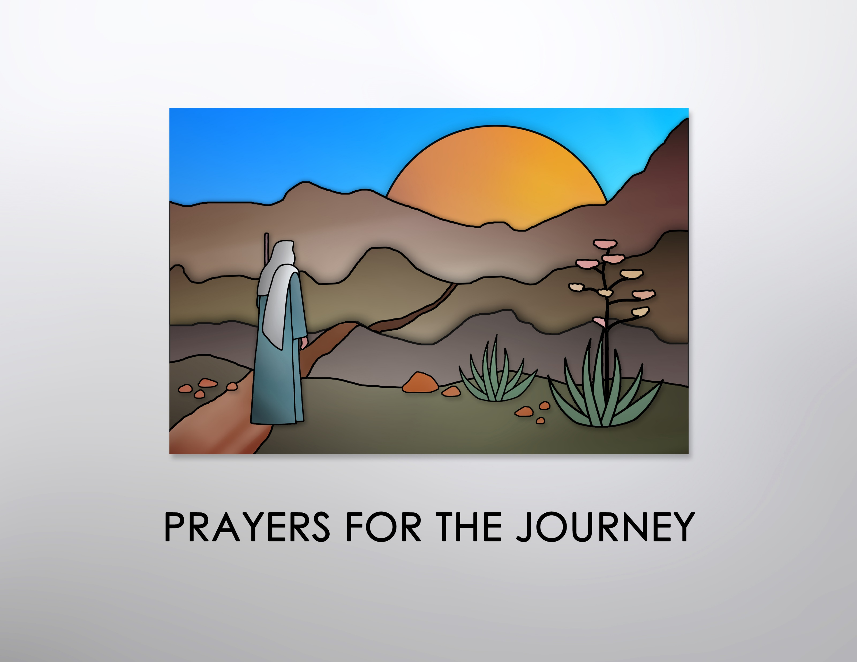
Photo Album
by Linda Henke

Slide 2
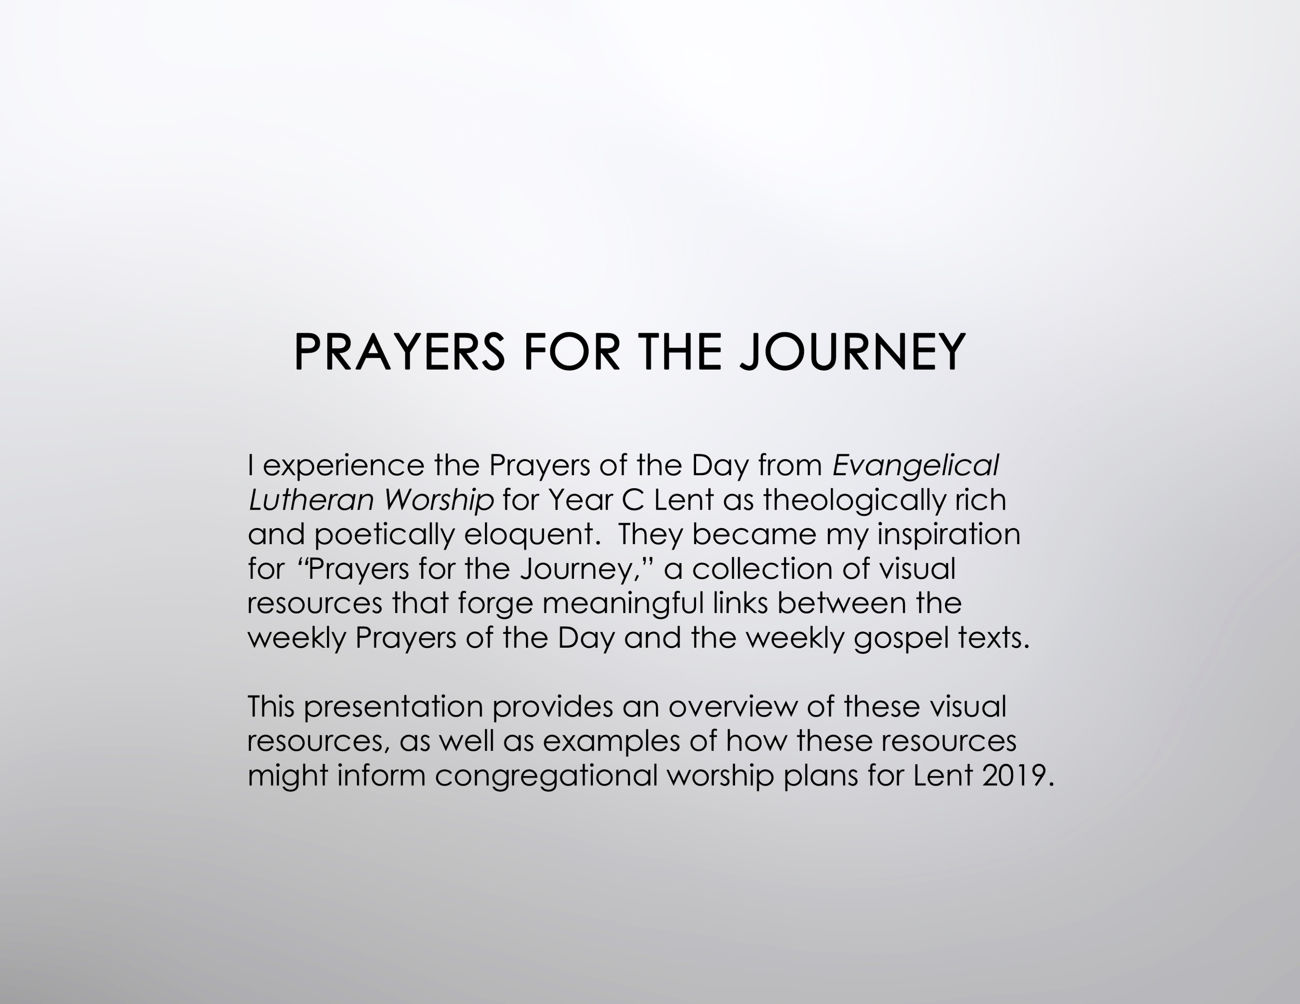

Slide 3
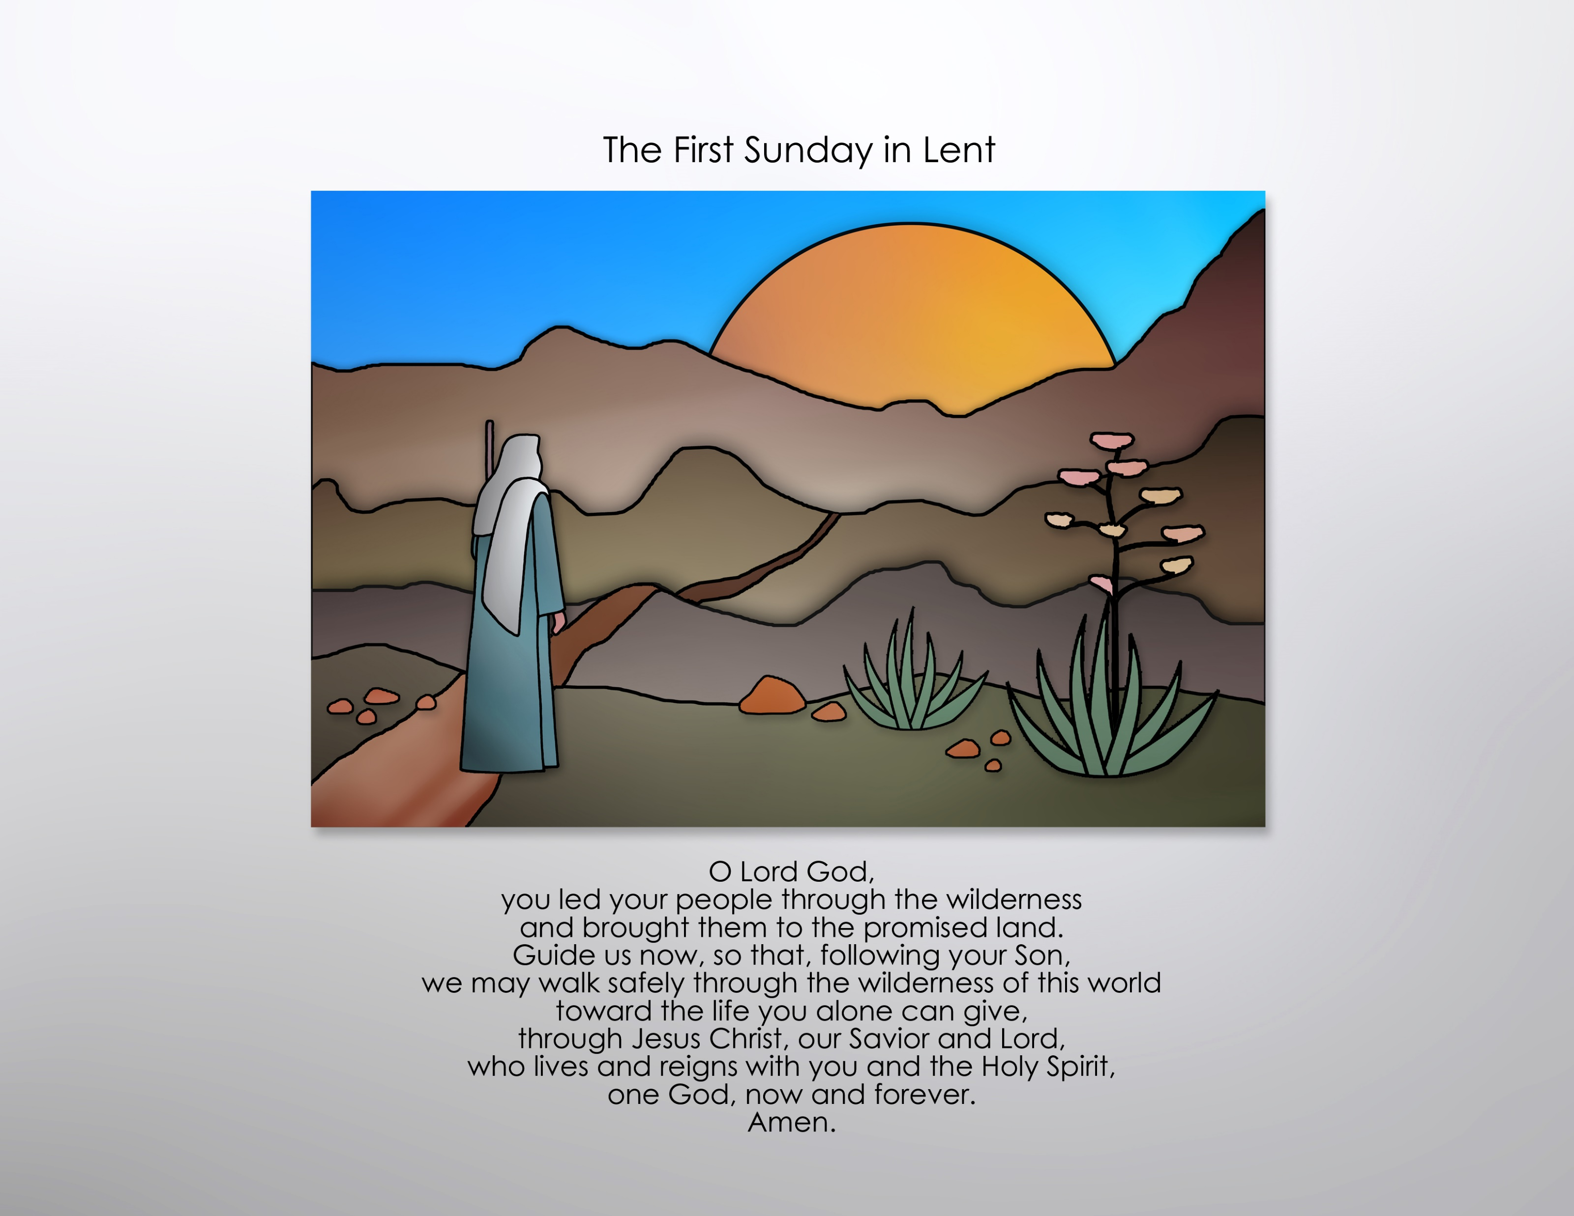

Slide 4
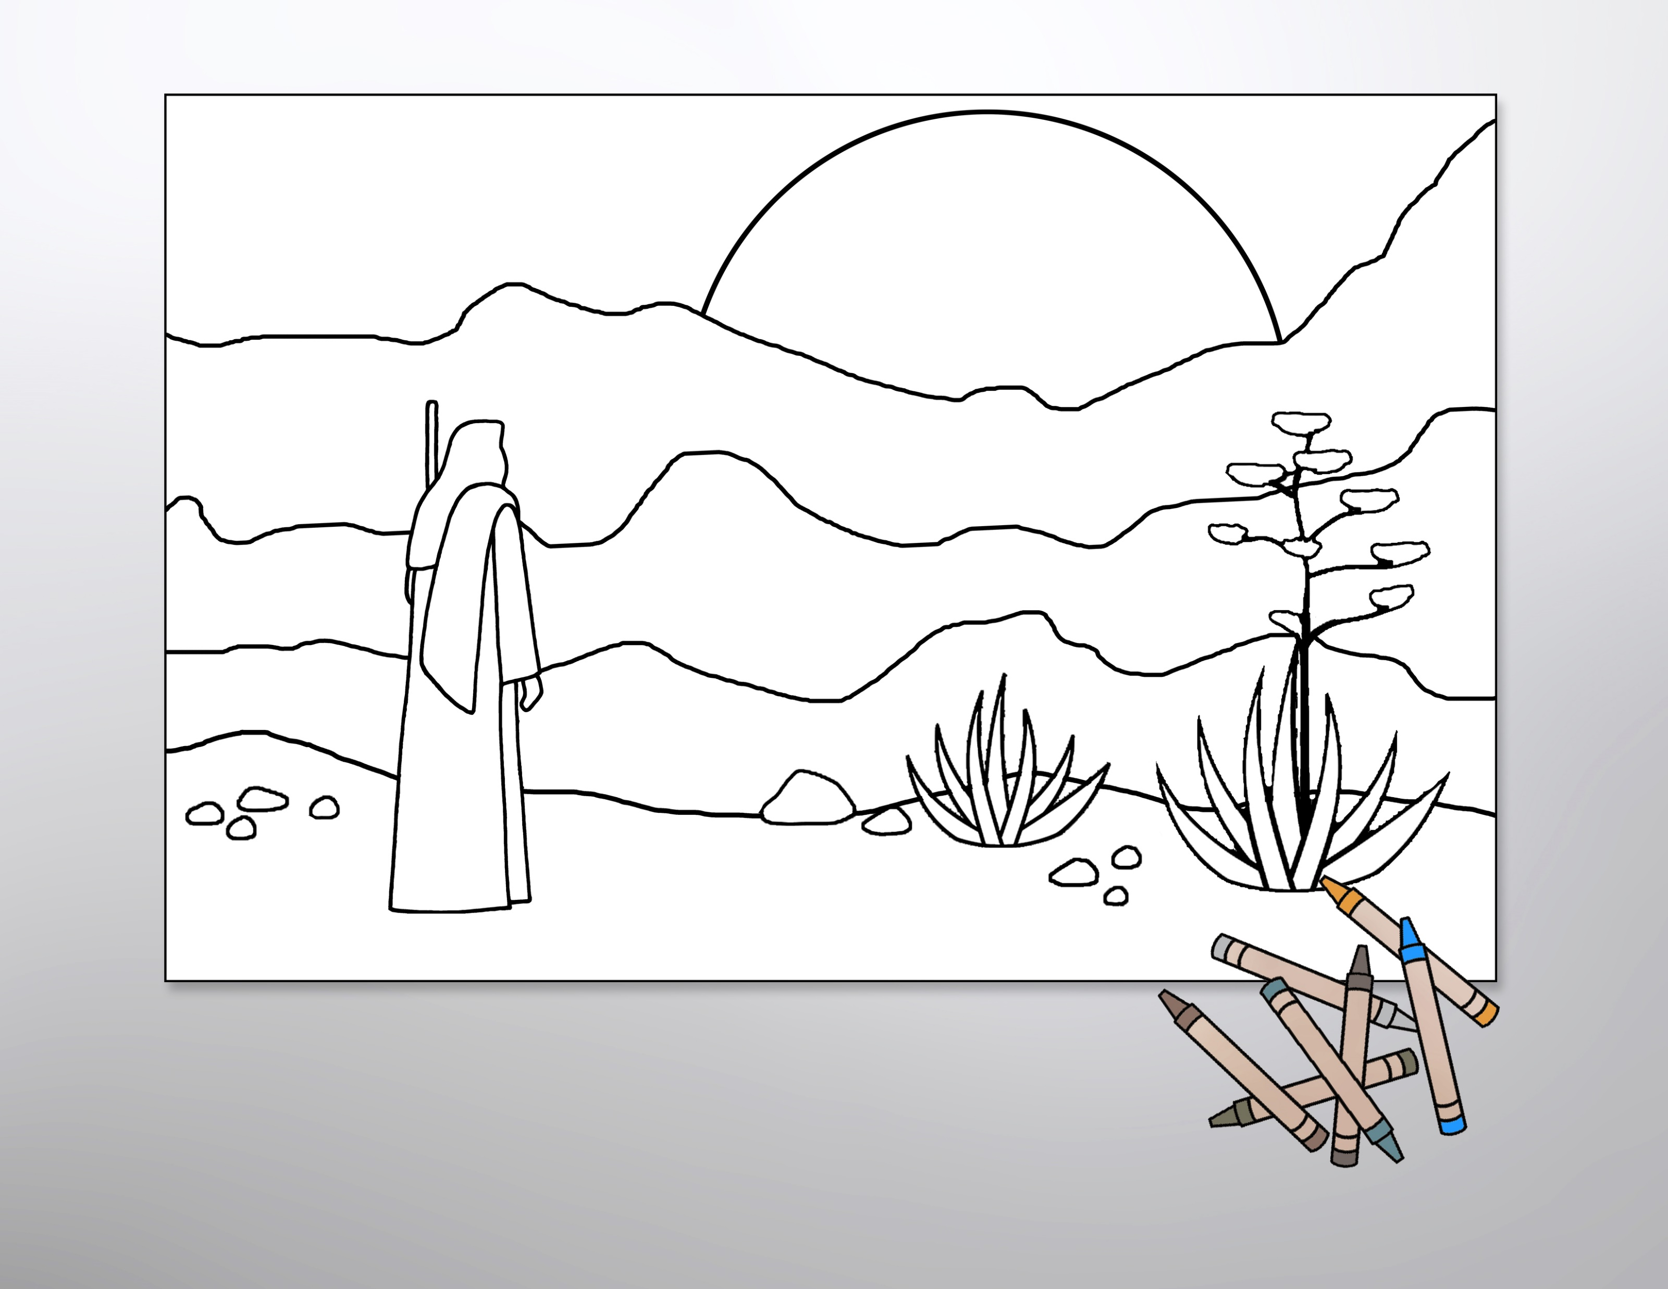
Use the line-art graphics as coloring sheets to help children connect with the gospel readings or enlarge them to poster size and use them as the basis for an intergenerational coloring project.

Slide 5
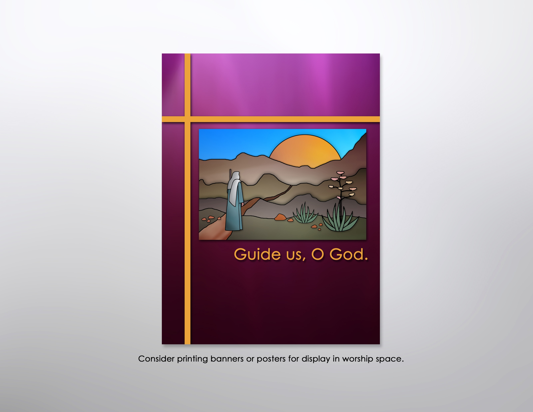

Slide 6
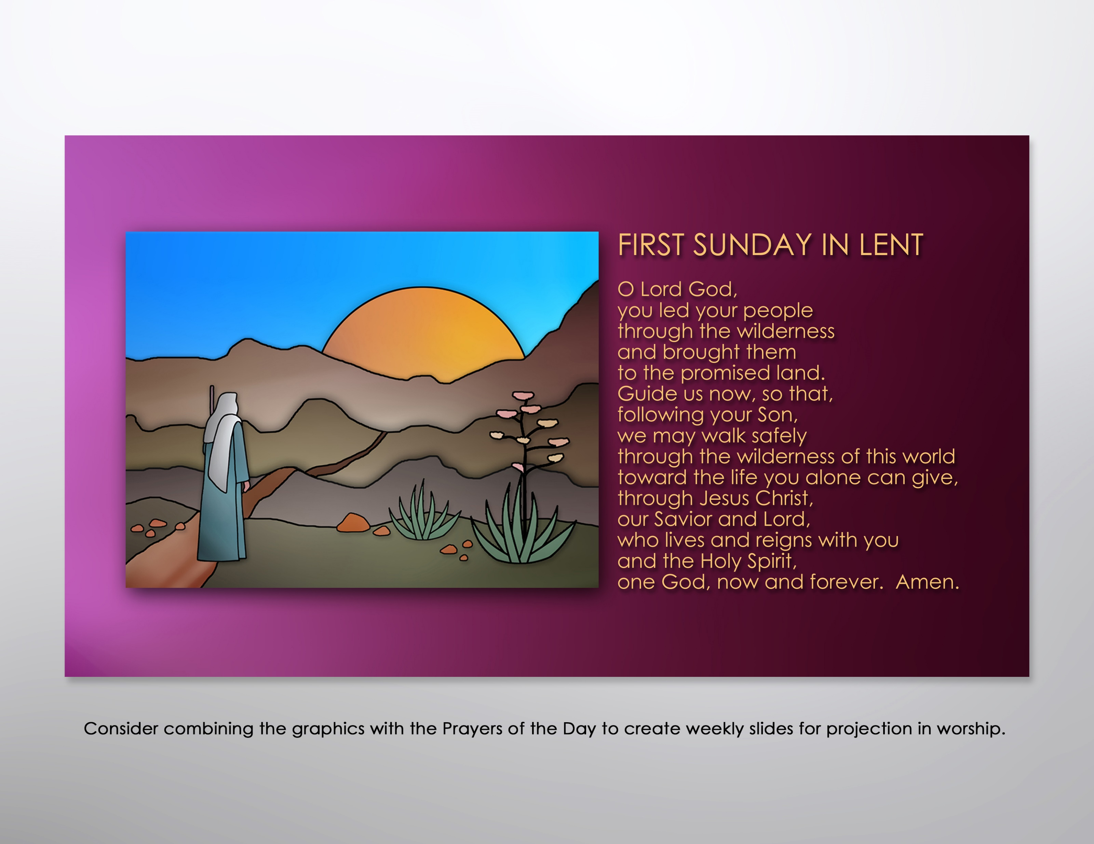

Slide 7
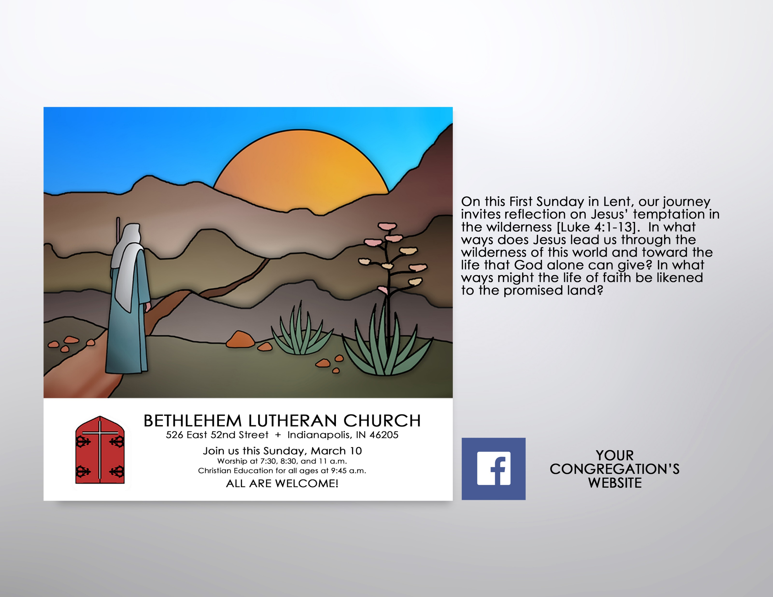
Encourage participation in Lenten worship by incorporating the color graphics into postings for the congregation’s website and/or FaceBook page. Consider using the accompanying text to prompt reflection on the overarching theme and weekly texts.

Slide 8
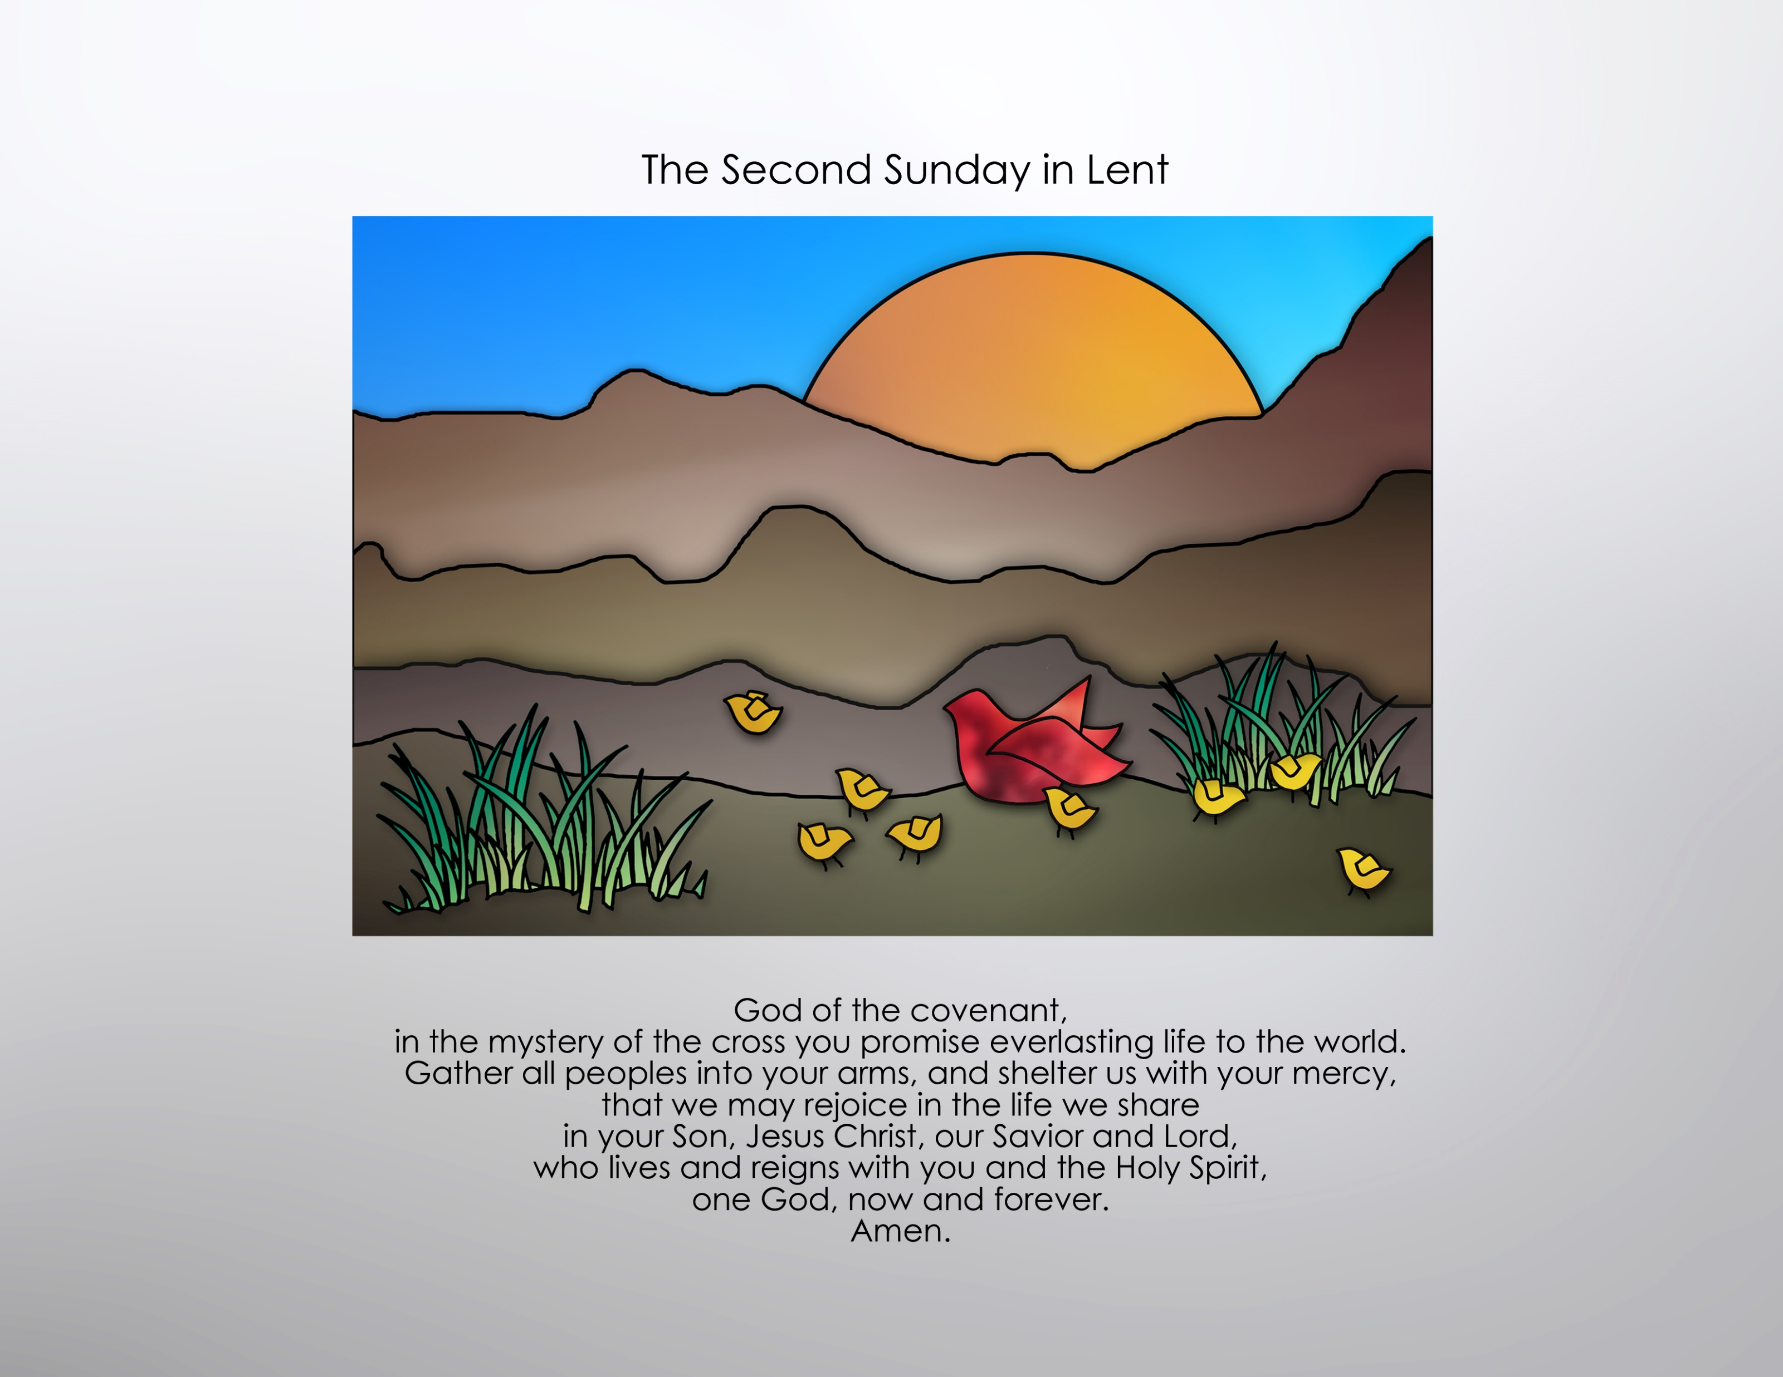

Slide 9
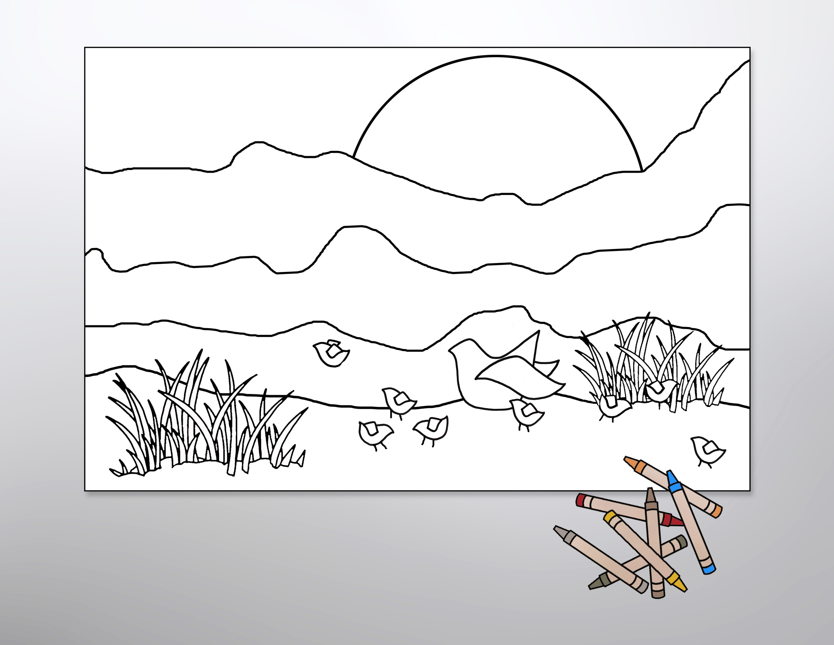
Use the line-art graphics as coloring sheets to help children connect with the gospel readings or enlarge them to poster size and use them as the basis for an intergenerational coloring project.

Slide 10
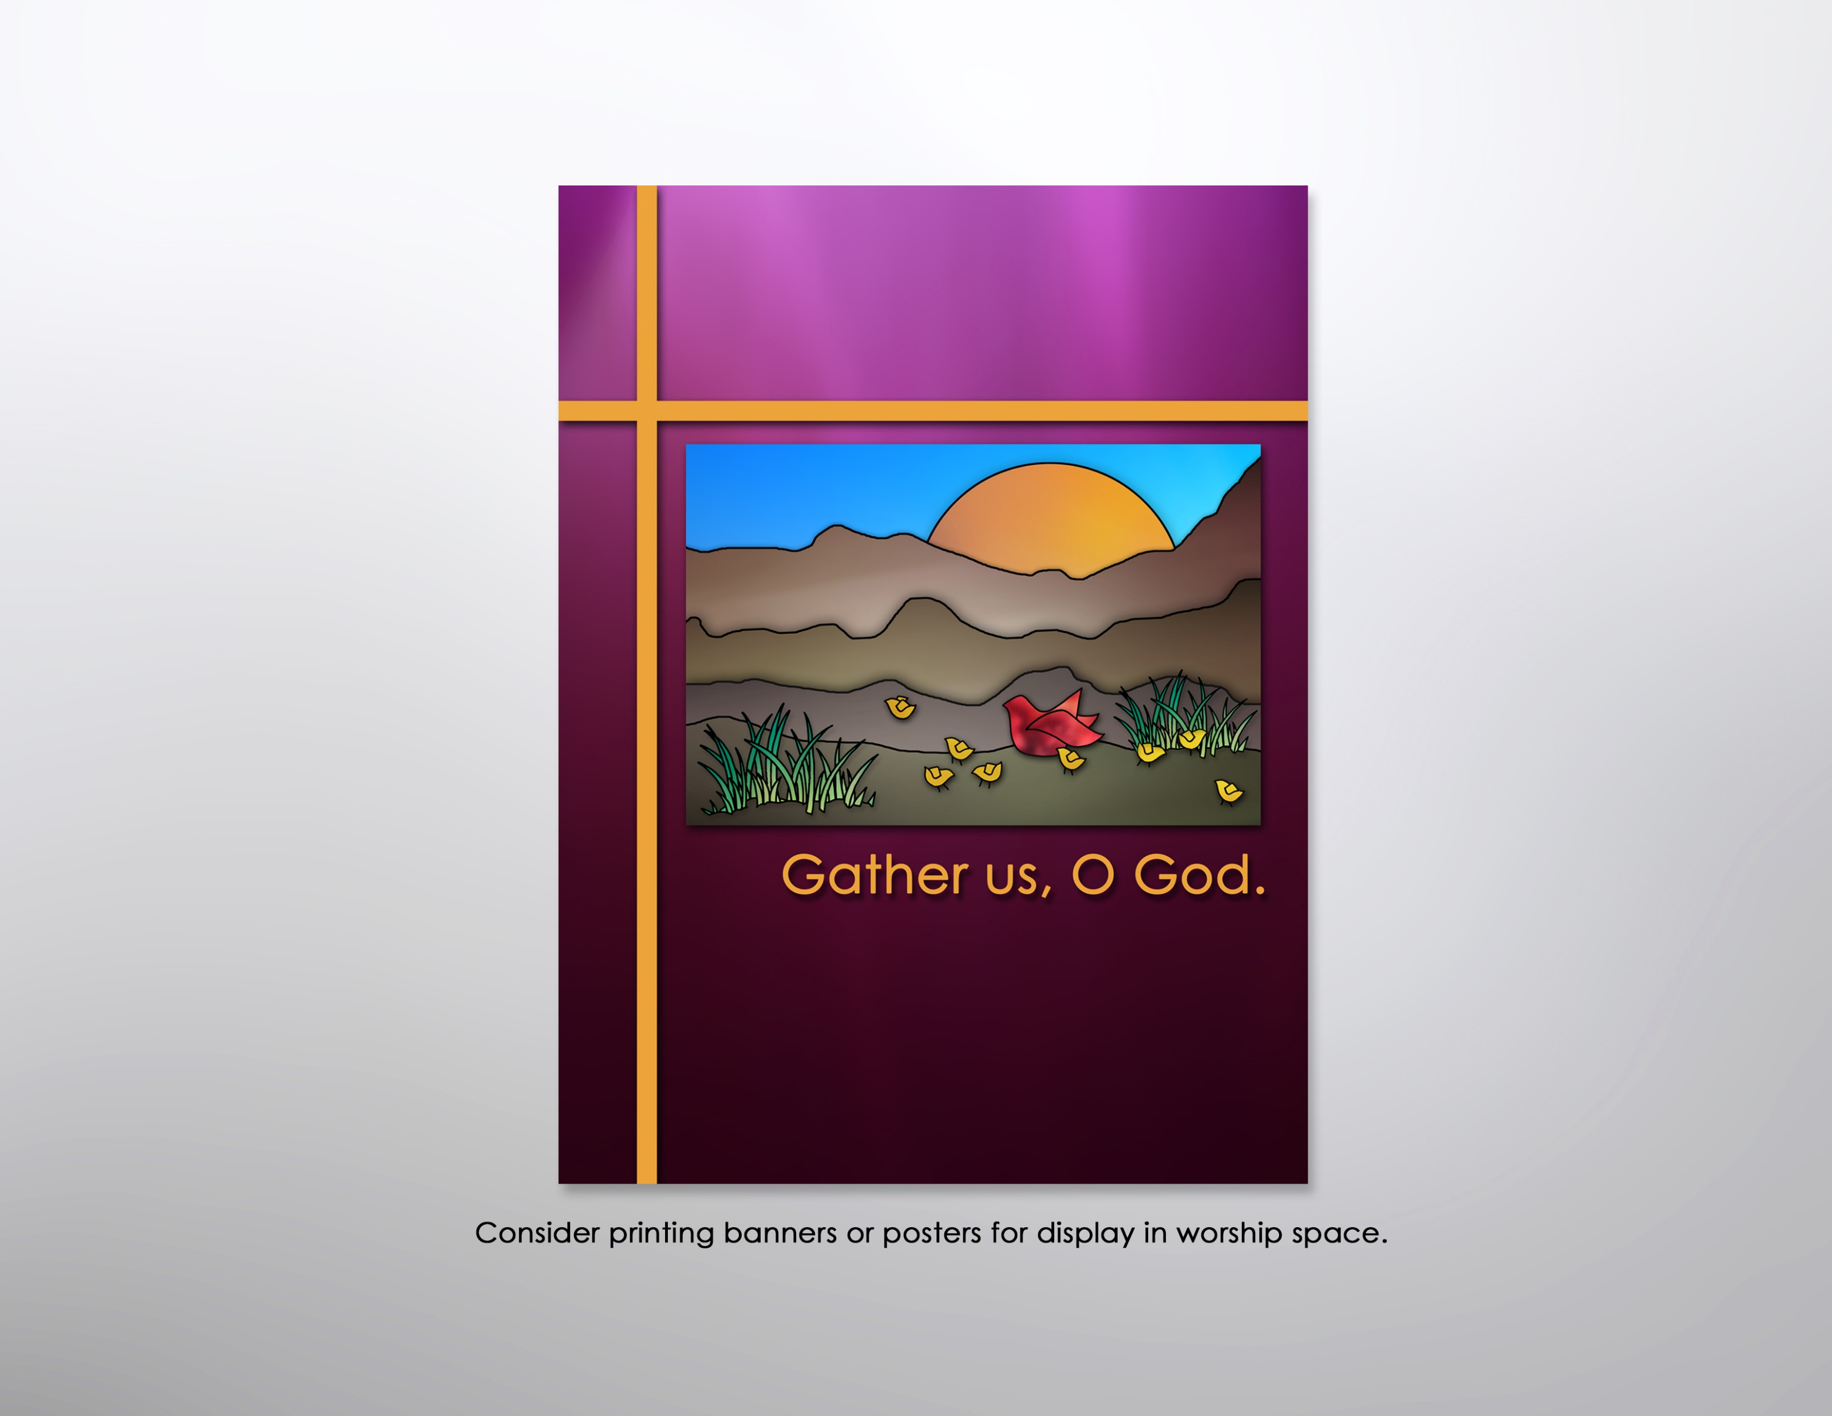

Slide 11
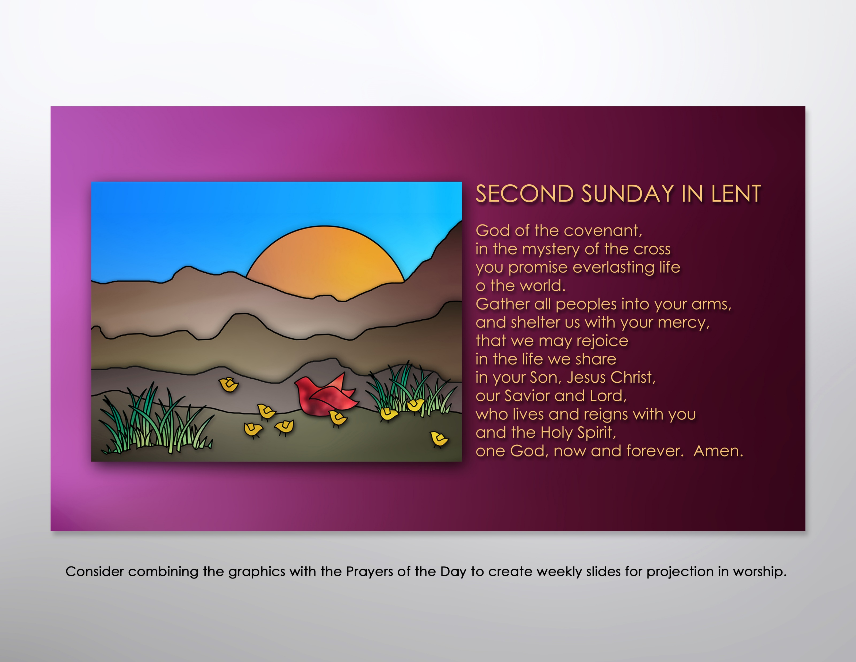

Slide 12
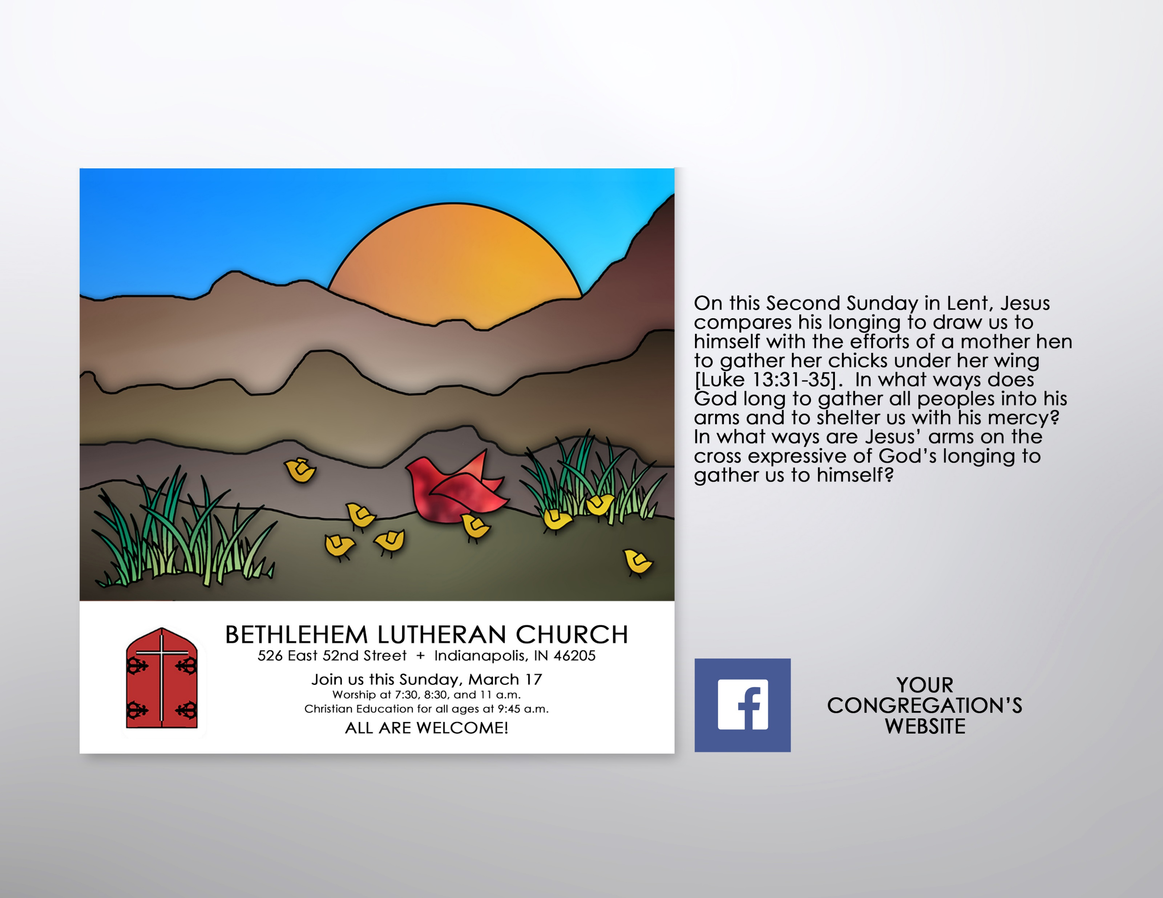
Encourage participation in Lenten worship by incorporating the color graphics into postings for the congregation’s website and/or FaceBook page. Consider using the accompanying text to prompt reflection on the overarching theme and weekly texts.

Slide 13
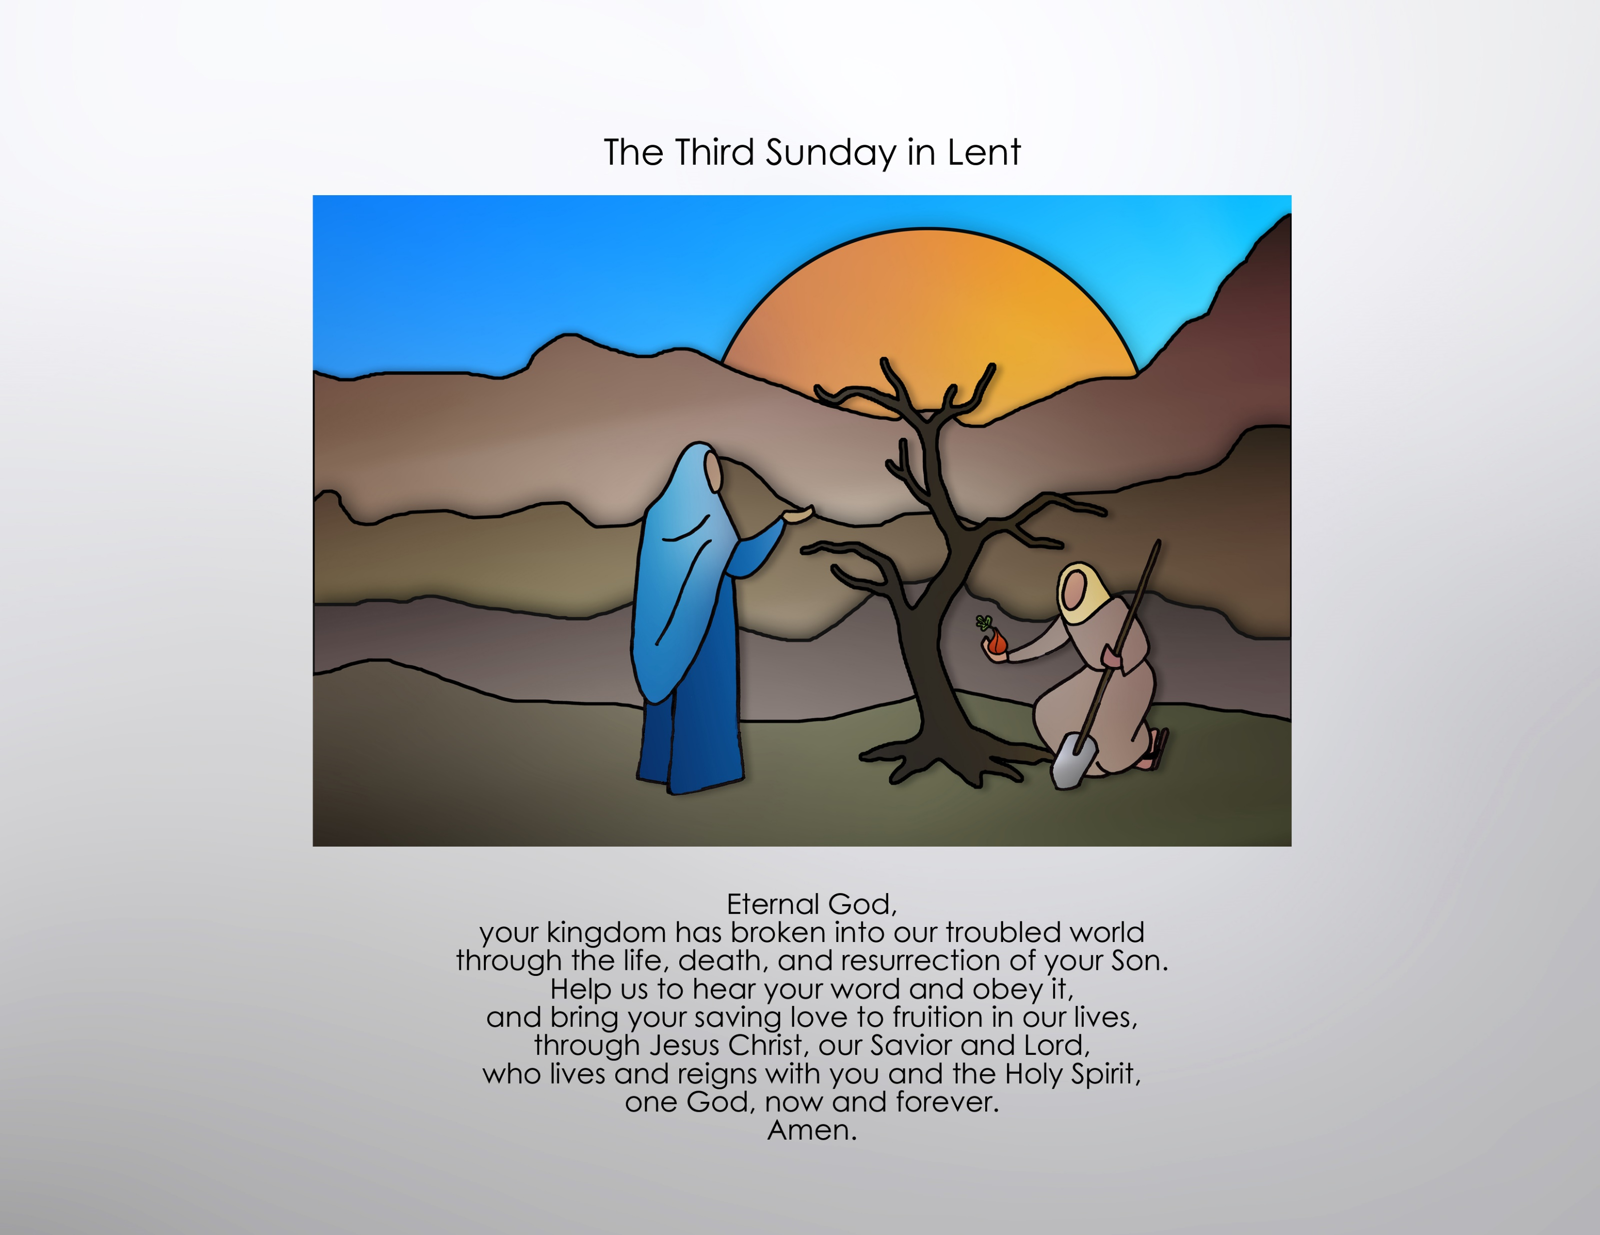

Slide 14
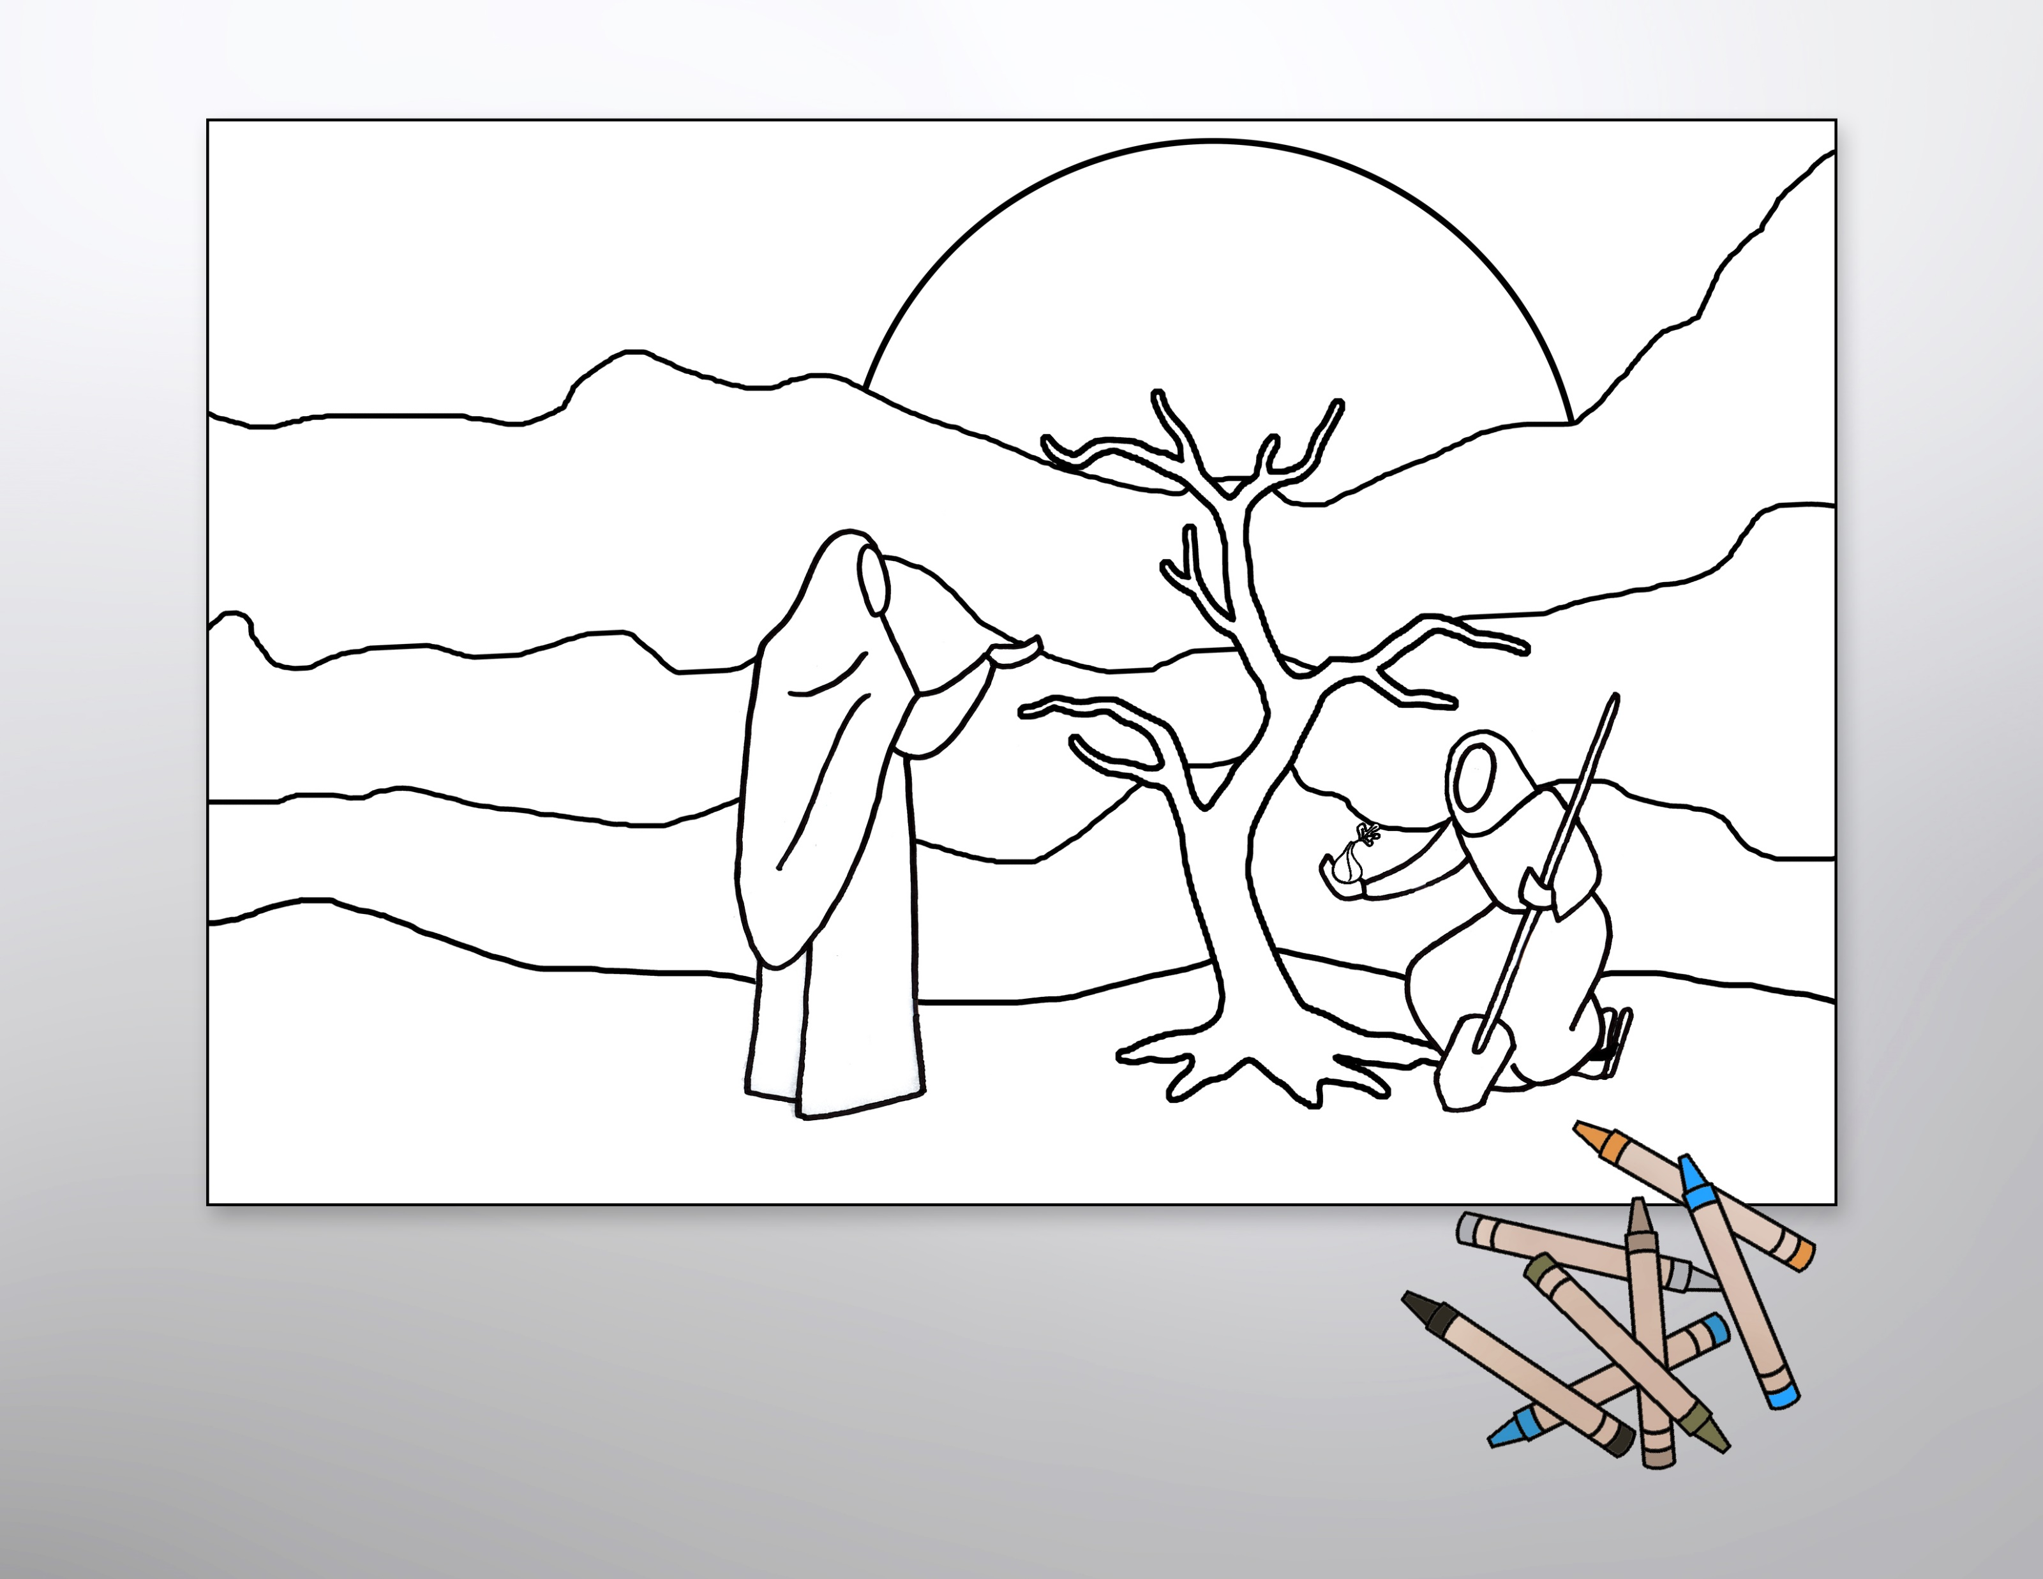
Use the line-art graphics as coloring sheets to help children connect with the gospel readings or enlarge them to poster size and use them as the basis for an intergenerational coloring project.

Slide 15
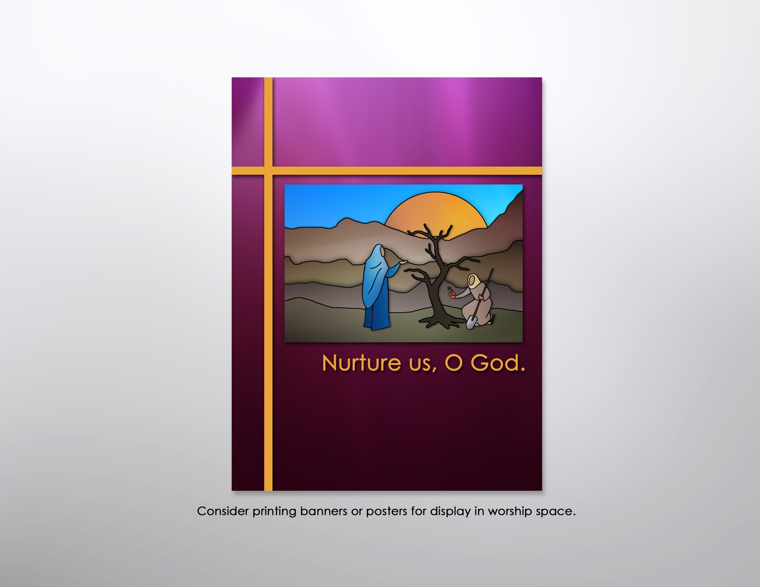

Slide 16
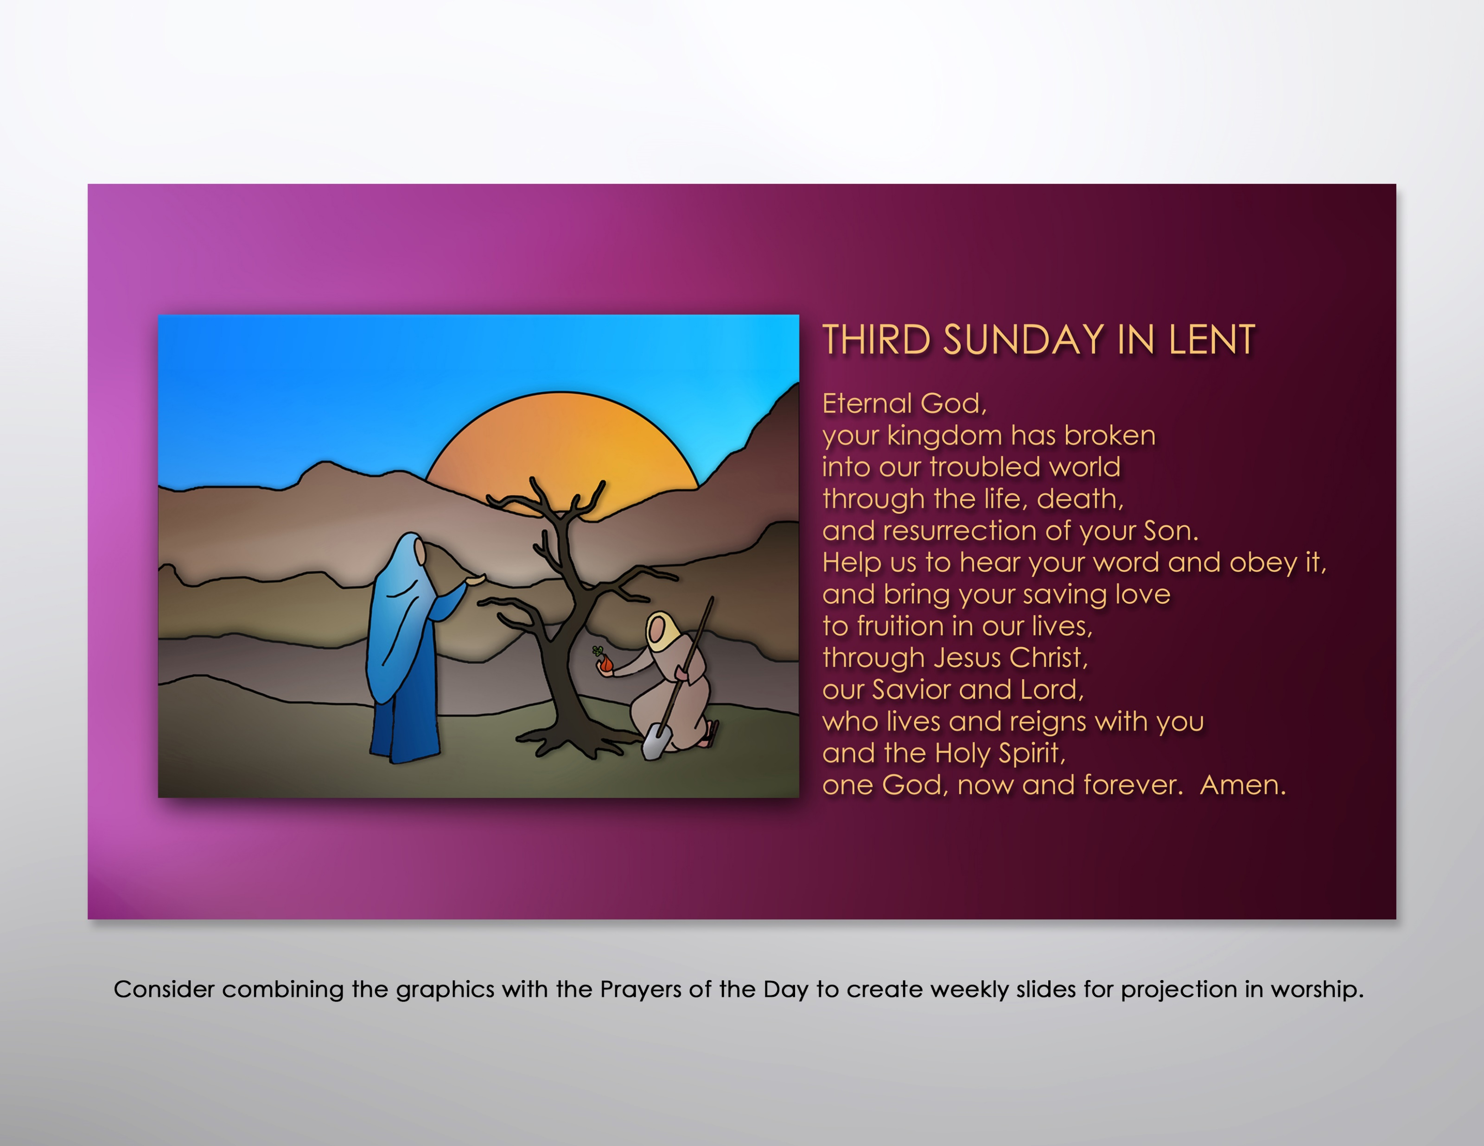

Slide 17
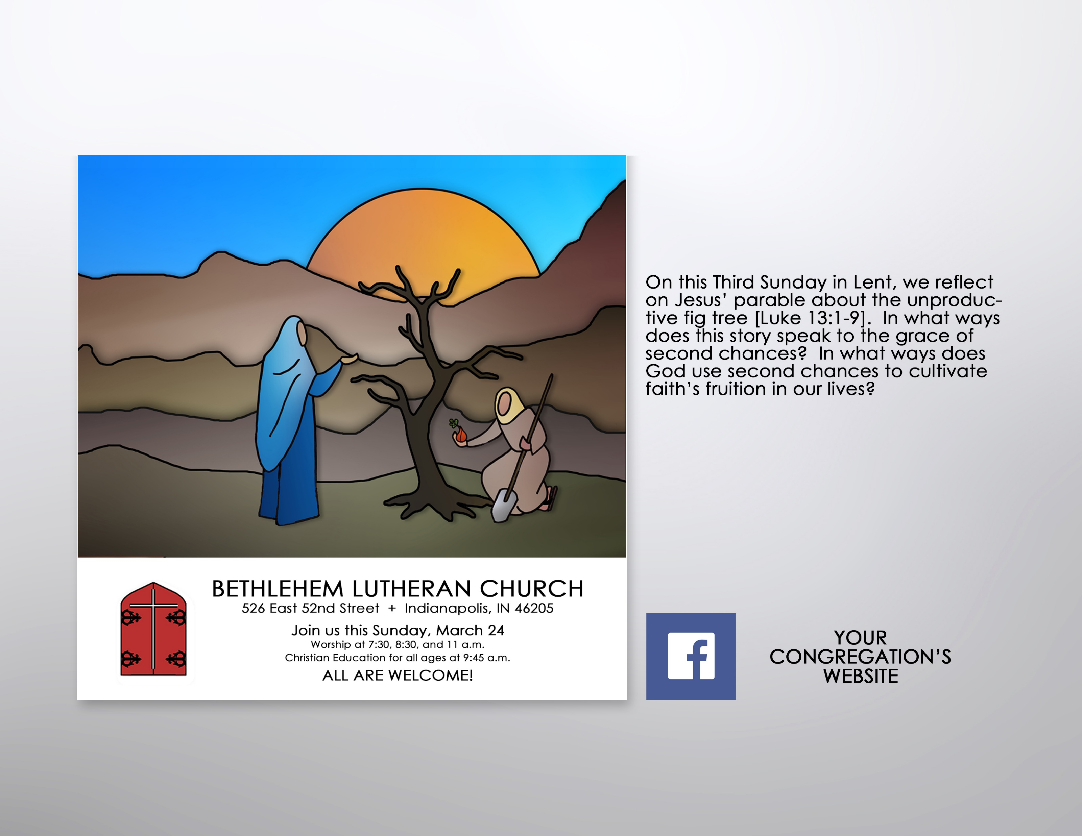
Encourage participation in Lenten worship by incorporating the color graphics into postings for the congregation’s website and/or FaceBook page. Consider using the accompanying text to prompt reflection on the overarching theme and weekly texts.

Slide 18
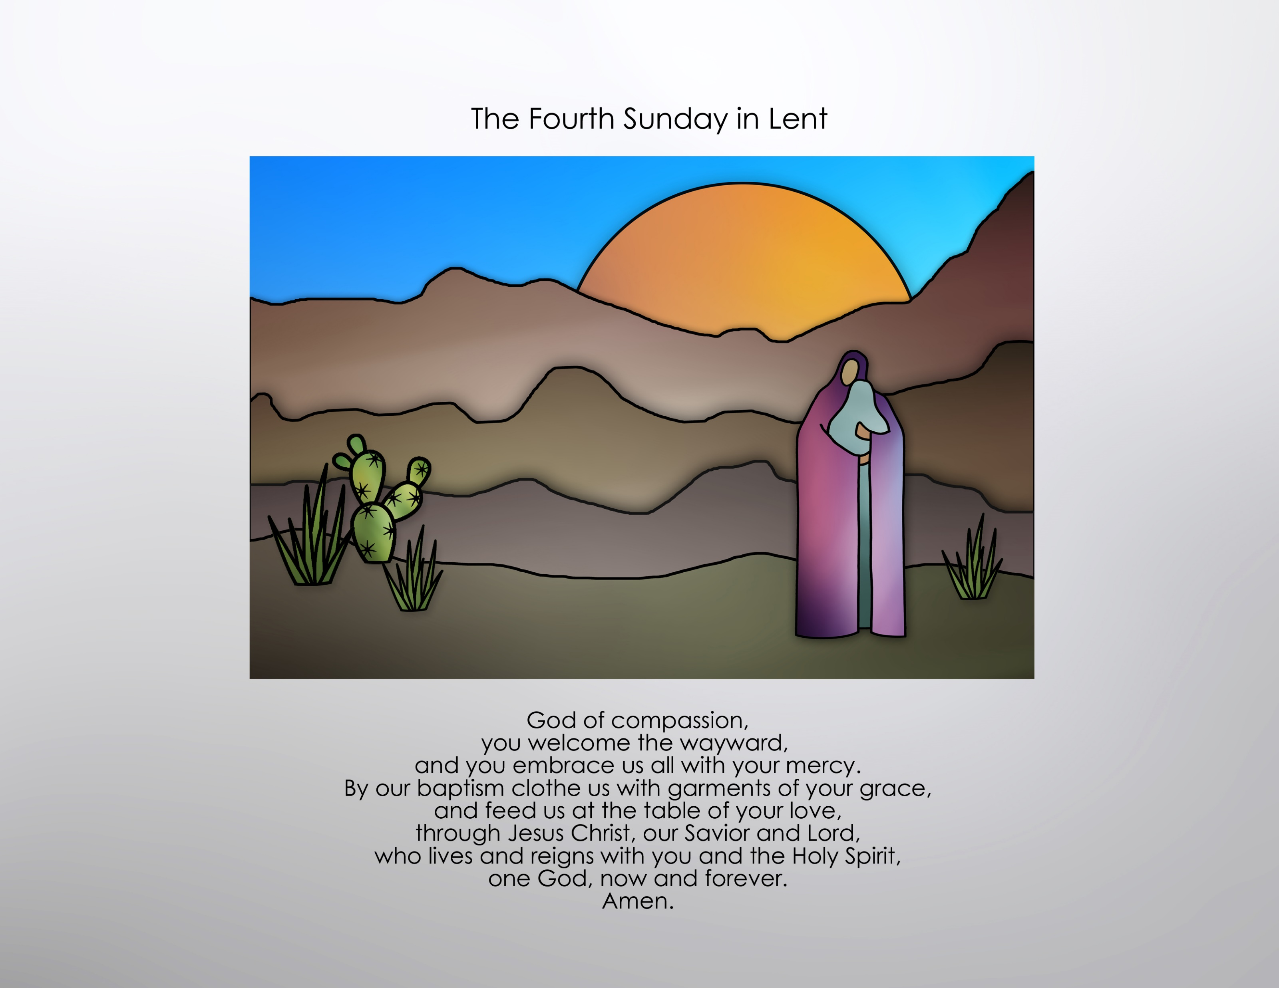

Slide 19
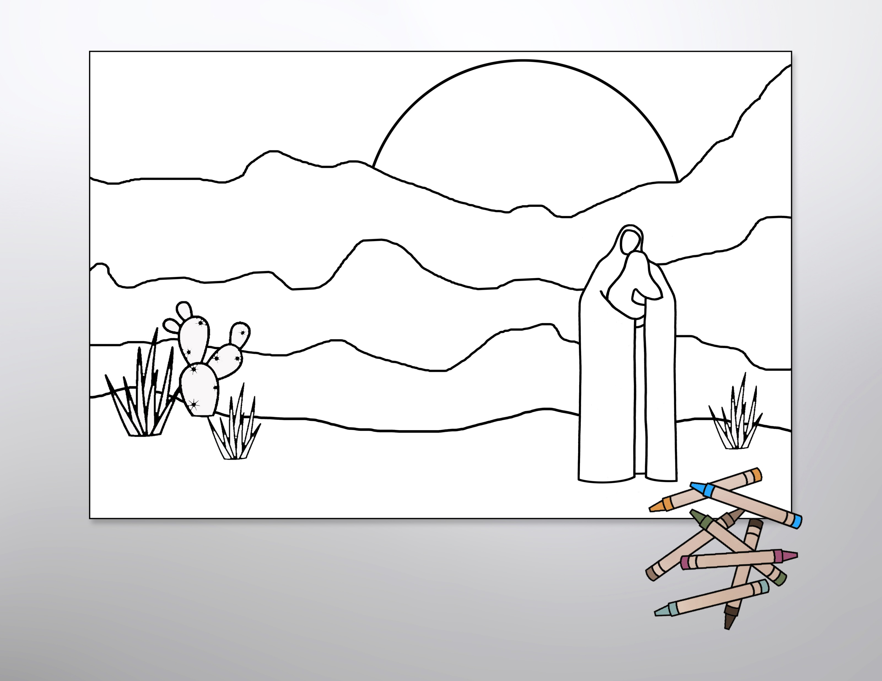
Use the line-art graphics as coloring sheets to help children connect with the gospel readings or enlarge them to poster size and use them as the basis for an intergenerational coloring project.

Slide 20
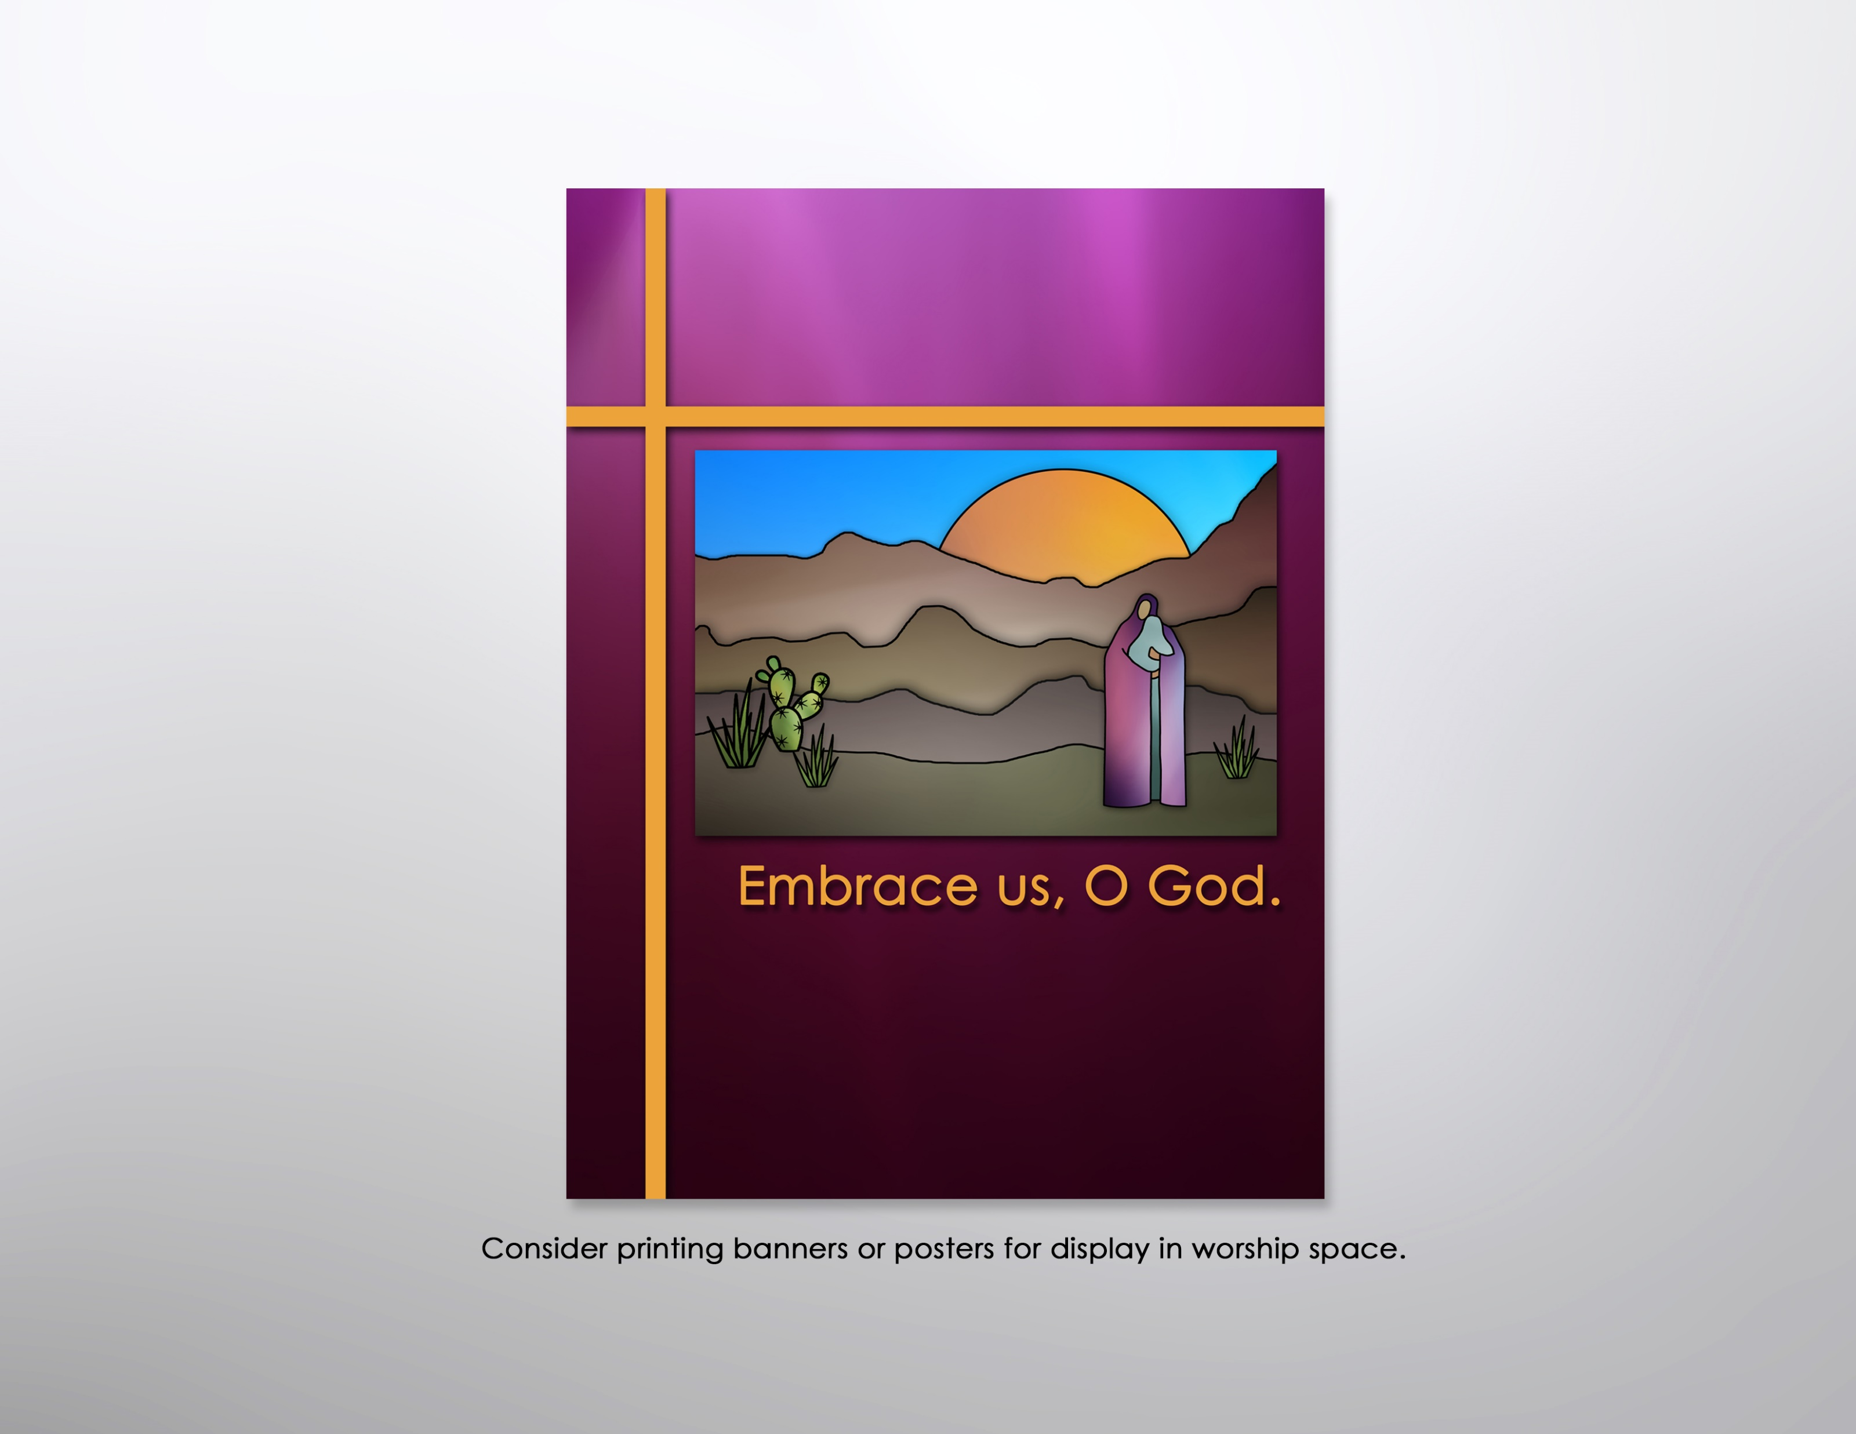

Slide 21
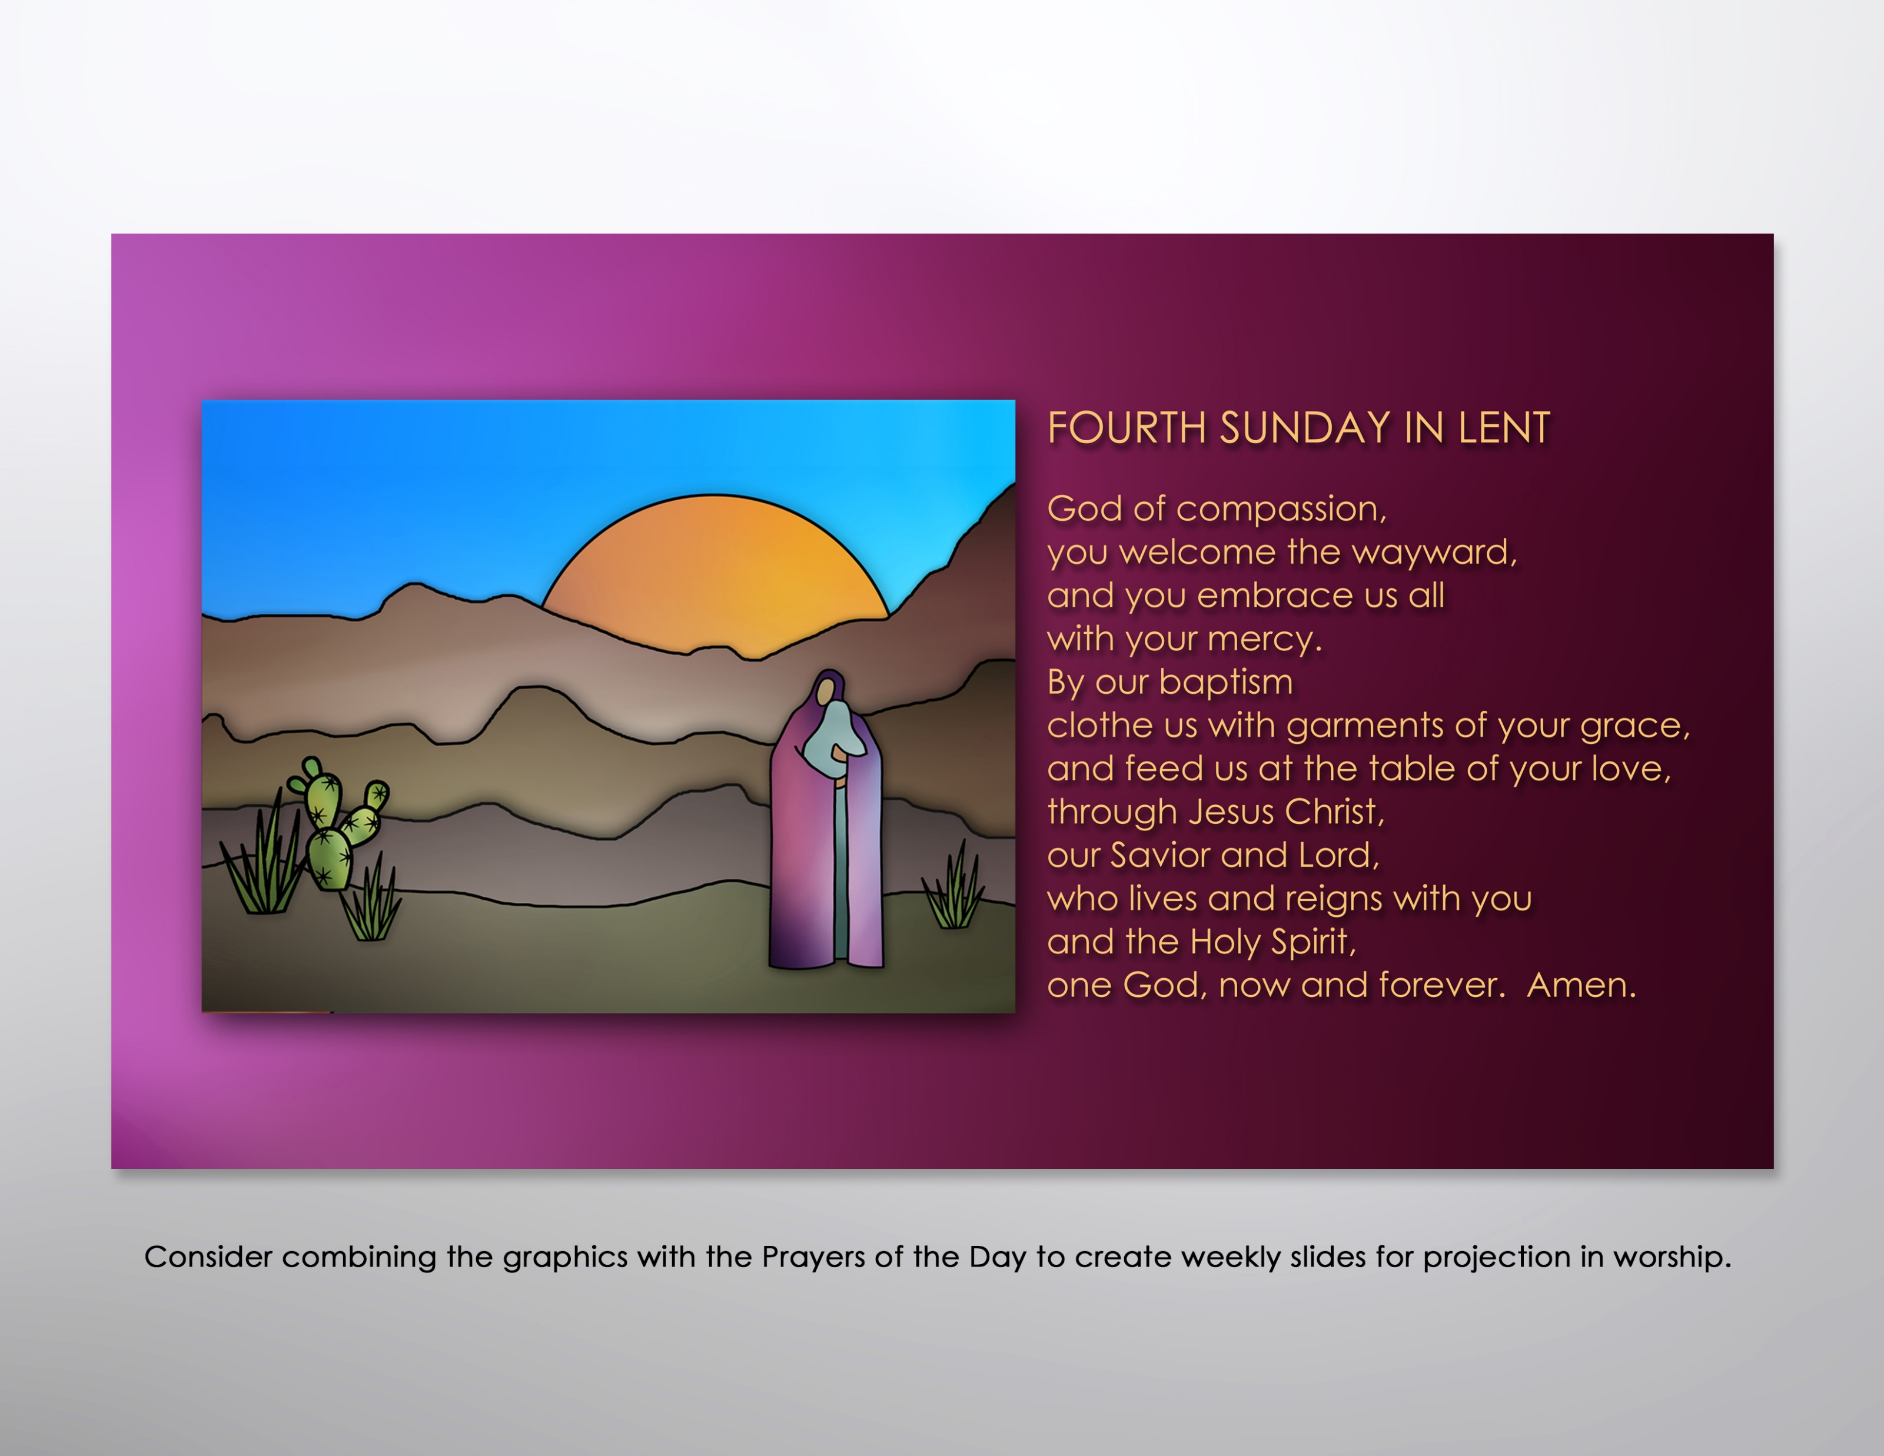

Slide 22

Encourage participation in Lenten worship by incorporating the color graphics into postings for the congregation’s website and/or FaceBook page. Consider using the accompanying text to prompt reflection on the overarching theme and weekly texts.

Slide 23
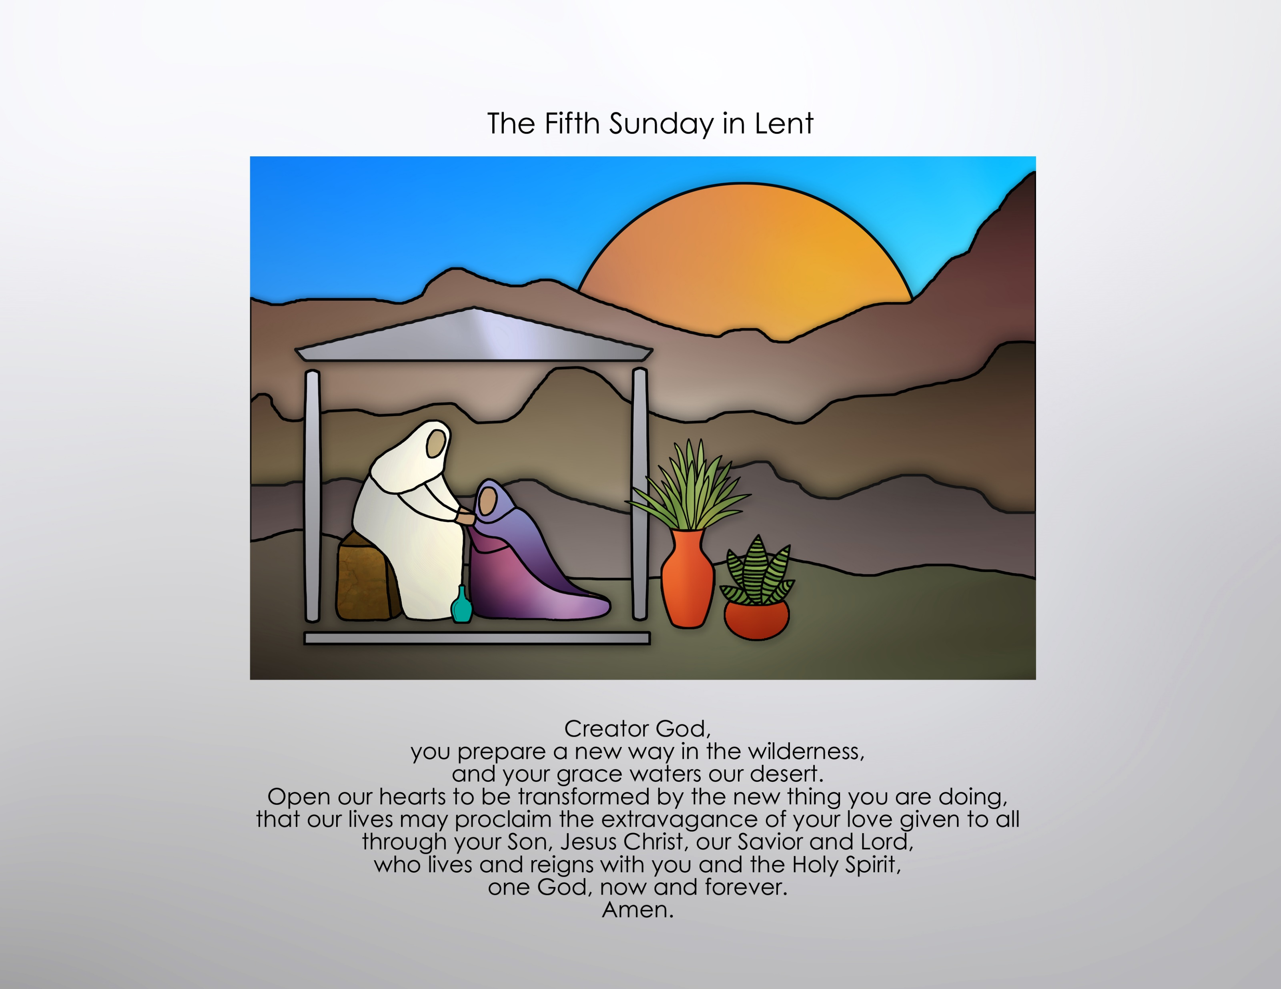

Slide 24
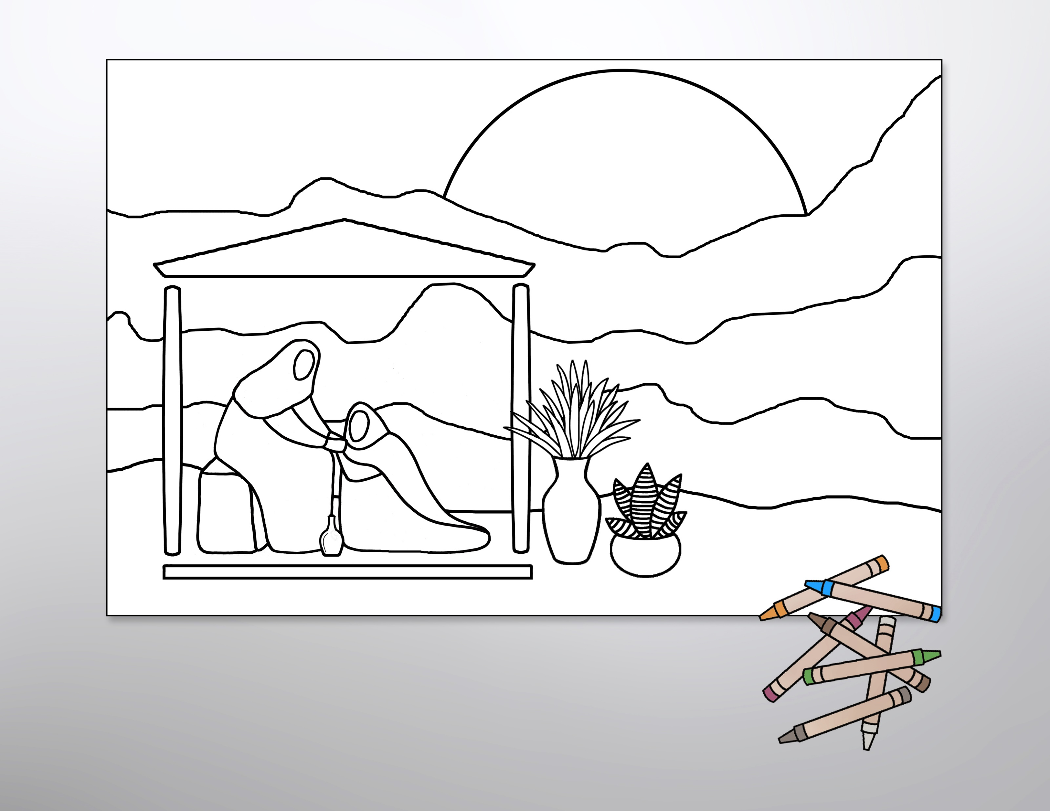
Use the line-art graphics as coloring sheets to help children connect with the gospel readings or enlarge them to poster size and use them as the basis for an intergenerational coloring project.

Slide 25
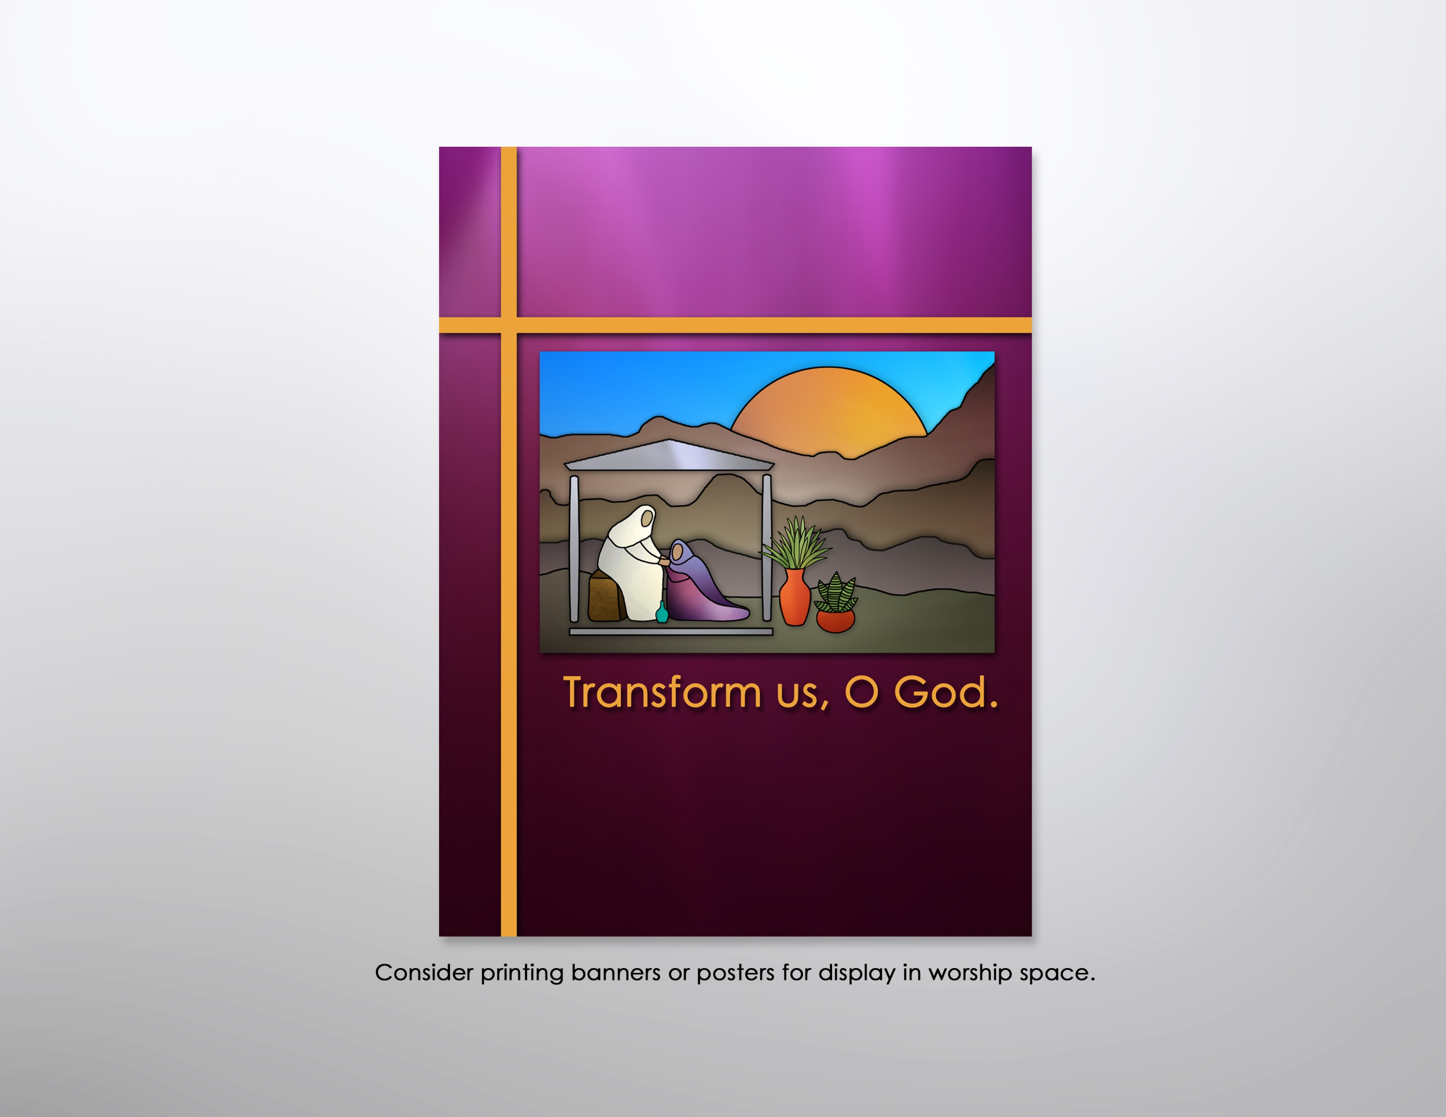

Slide 26
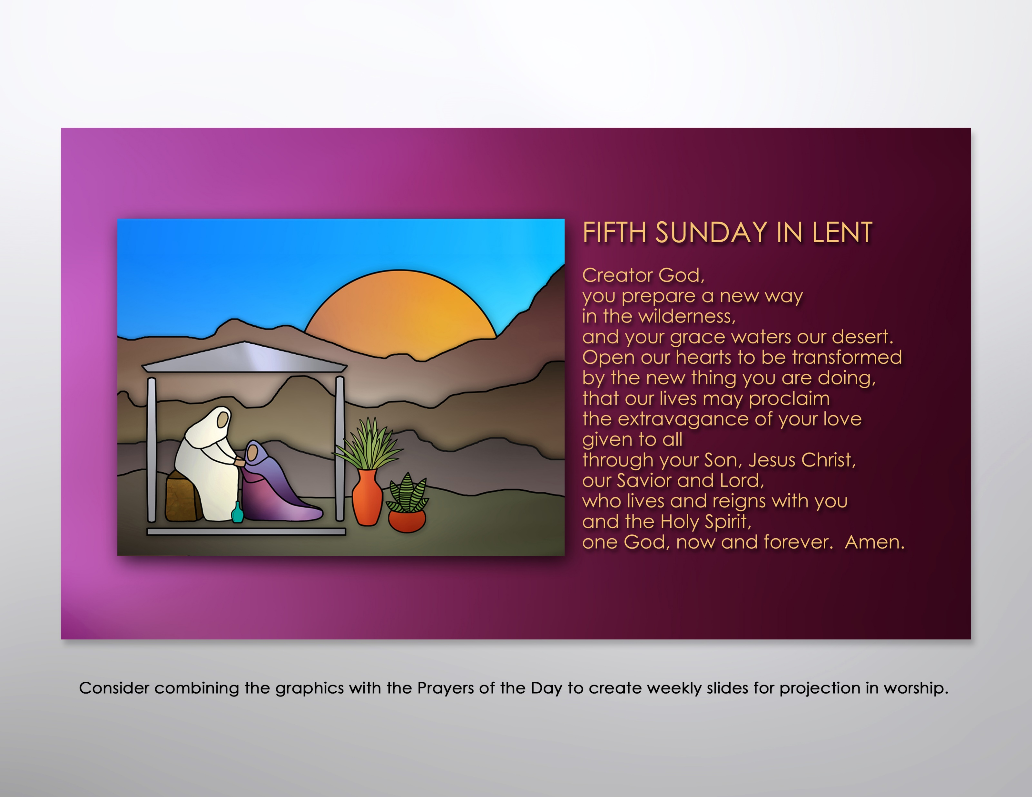

Slide 27
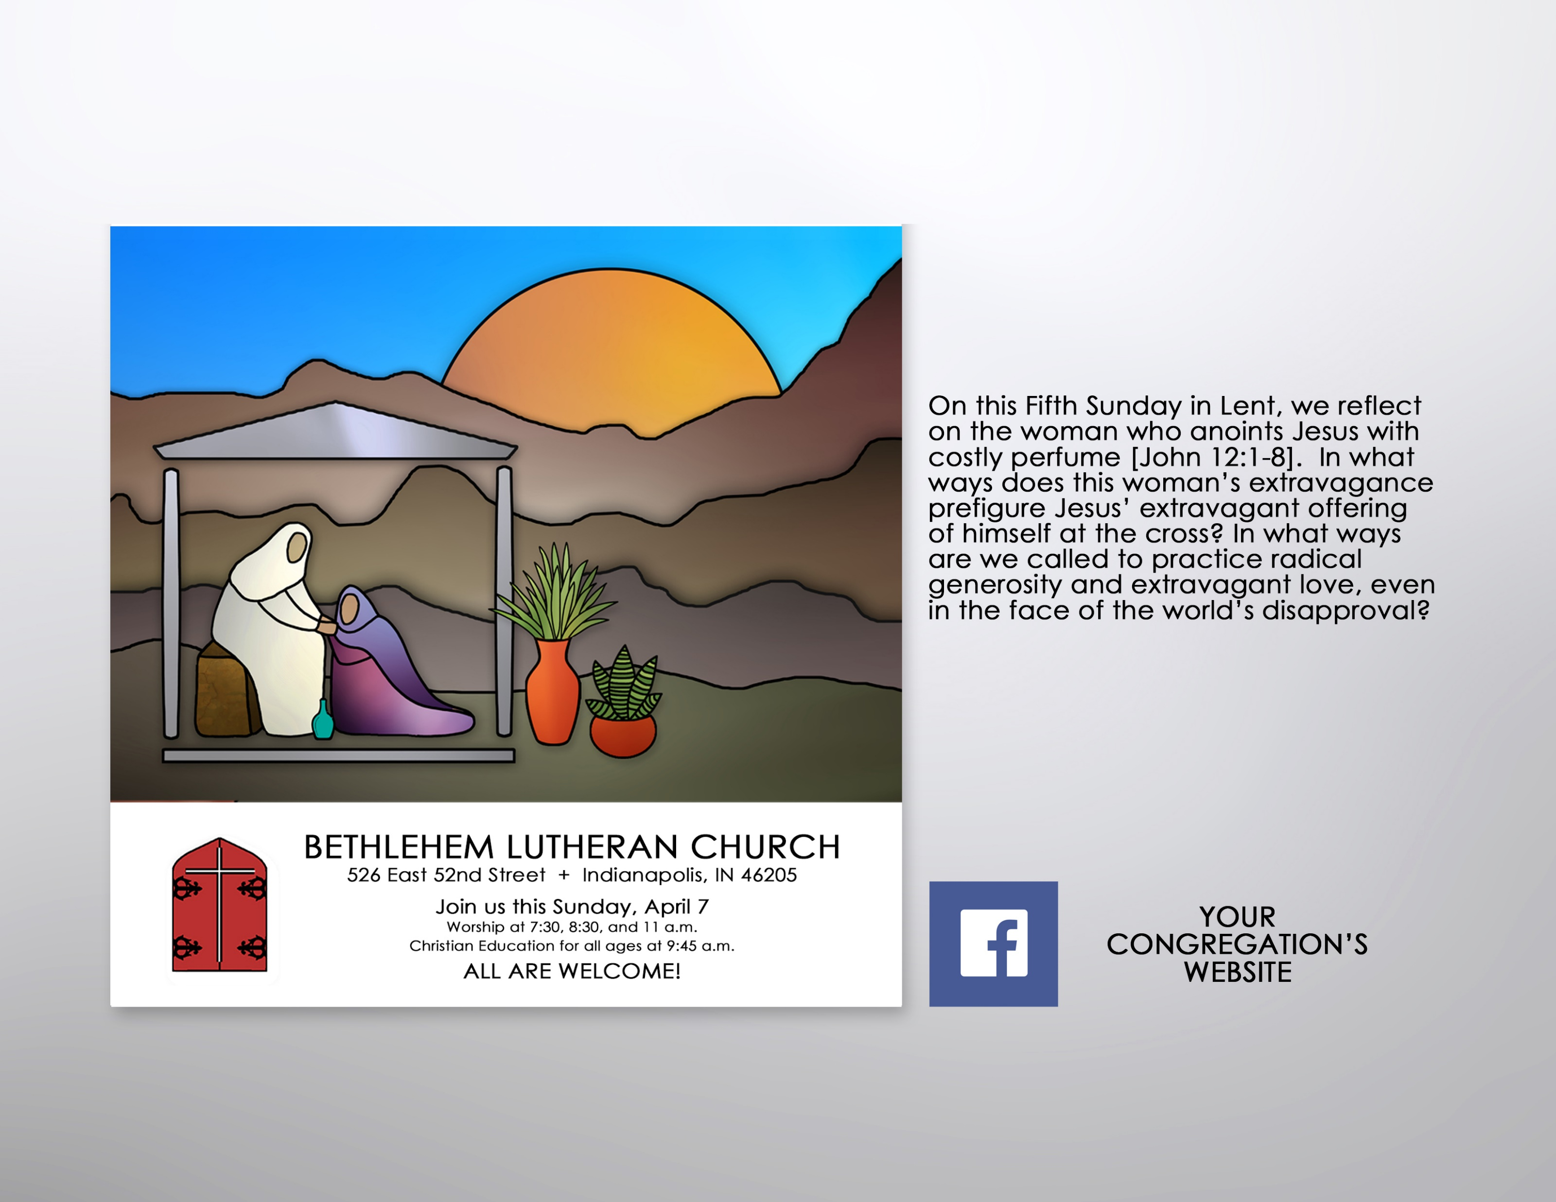
Encourage participation in Lenten worship by incorporating the color graphics into postings for the congregation’s website and/or FaceBook page. Consider using the accompanying text to prompt reflection on the overarching theme and weekly texts.

Slide 28
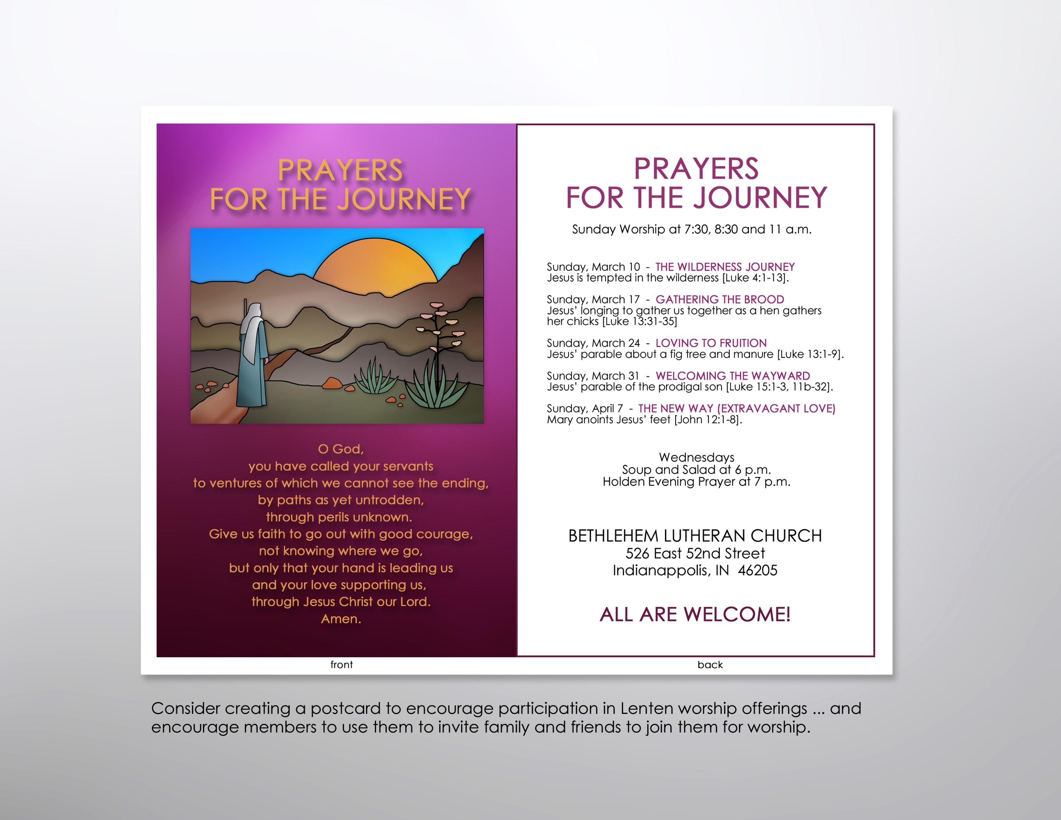

Slide 29
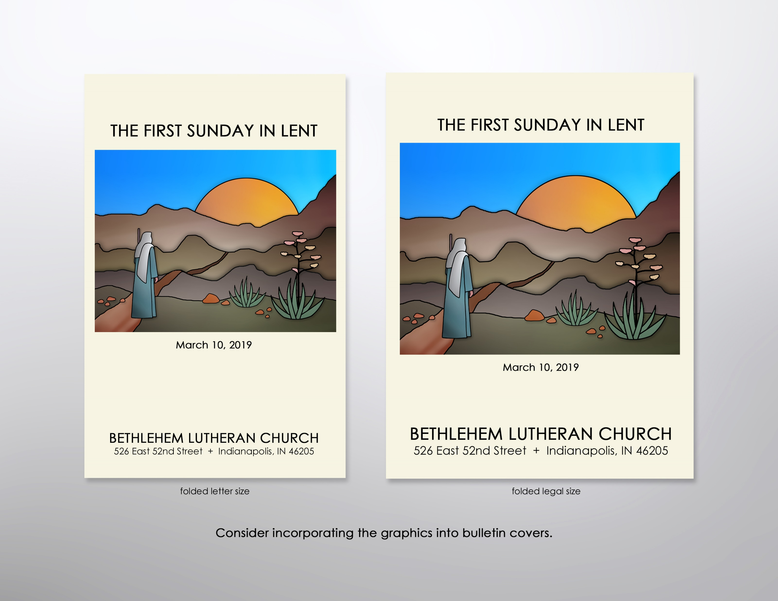

Slide 30
