Slide 1
Poverty and Hunger
Updated data for 2020

Slide 2
How to Use
Please use this presentation for your own information or to help prepare for presentations, develop newsletter content or otherwise to raise awareness about hunger within your congregation.
This data was analyzed for this presentation in November 2020.
Please do not repost this presentation on personal or congregational websites or otherwise online.
If you have questions, please contact Ryan Cumming at Ryan.Cumming@elca.org.

Slide 3
Sources
Census Bureau – domestic poverty
Current Population Survey
American Community Survey
USDA, State of Food Security – domestic hunger
FAO – global food security
World Bank – global poverty

Slide 4
Domestic US
Poverty and Income

Slide 5
U.S. POVERTY THRESHOLDS- 2019
1 person (average): $13,011
1, under 65: $13,300 1, 65 or older: $12,261
2 people: $16,521
3 people: $20,335
4 people: $26,172
Notes:
Three times the cost of a minimum food diet in 1963, adjusted for prices by the Consumer Price Index
Source: Census Bureau

Slide 6
U.S. OFFICIAL POVERTY - 2019
10.5% of Americans were living in poverty in 2019 (down from 11.8% in 2018)
34.0 million people, (down from 38.2 million in 2018)
14.4% of children were living in poverty in 2019 (down from 16.2% in 2018)
10.5 million children, down from 11.9 million in 2018
Notes:
Source: Census, Income and Poverty 2019 (CPS ASEC)

Slide 7
Poverty by Race, 2019
Non-Hispanic White
Black
Hispanic
Poverty Rate: 7.3%
Count: 14.2M
Decline, 2018-2019: 0.8%
Poverty Rate: 18.8%
Count: 8.1M
Decline, 2018-2019: 2.0%
Poverty Rate: 15.7%
Count: 9.5M
Decline, 2018-2019: 1.8%
Notes:
Source: Census, Income and Poverty 2019 (CPS ASEC)

Slide 8
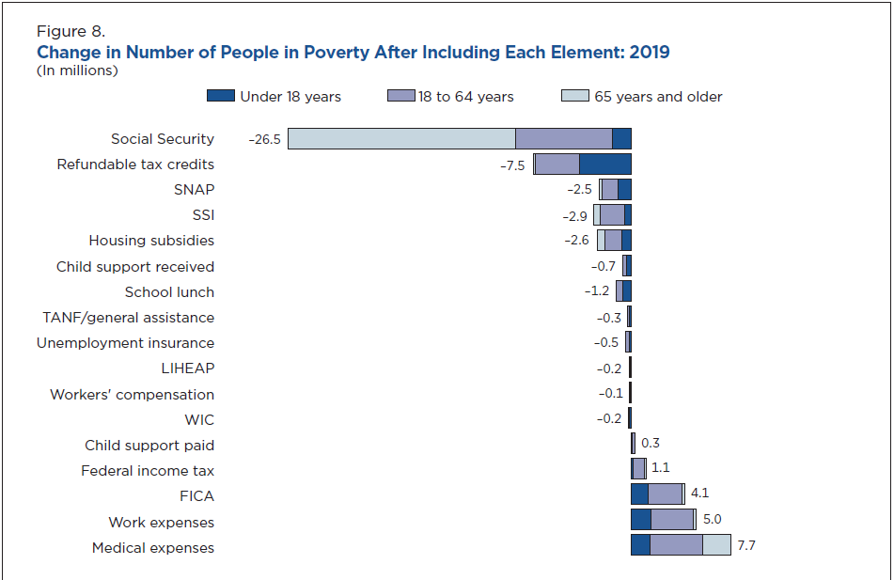
Notes:
Source: Census, SPM 2019
CHECKED

Slide 9
Domestic US
Food Security

Slide 10
U.S. FOOD SECURITY - 2019
Food insecure – lacked access to enough food for an active, healthy life for all household members
“Recurrent not chronic”
10.5% of households were food insecure at least some time during 2019 (decrease from 11.1% in 2018) – 10.9% of individuals
35.2 million were in food-insecure households (down from 37.2M in 2018)
4.1% had very low food security (disruption in eating patterns) (2018 – 4.3%)
11.845 million people had very low food security
Notes:
Source: USDA, Food Security in US 2019

Slide 11
Child Food Security - 2018
Very tricky to measure
Often, only adults are food-insecure
Not all children are food-insecure
Children were food-insecure in 6.5% of households (down, but not significantly, from 7.1% in 2018 – lowest level since 1998)
5.332M children, or 7.3% of children (2018 – 6M)
Both children and adults experienced very low food security in 0.6% of households
“children were hungry, skipped a meal, or did not eat for a whole day”
361,000 children, or 0.5% (560,000 or 0.7% in 2018)
Notes:
Source: USDA, Food Security 2019

Slide 12
Global
Poverty and Income

Slide 13
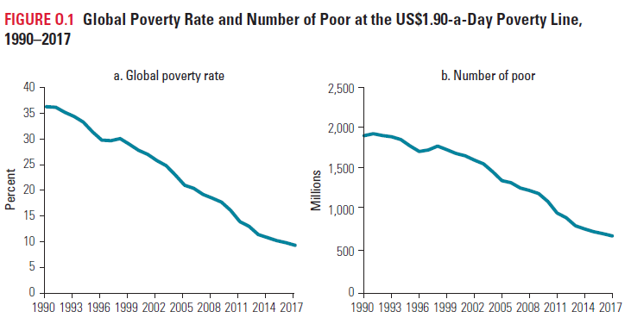
Global Poverty by the Numbers
Global extreme poverty threshold = $1.90/day
9.2% in 2017 (most recent year) – down from 10% in 2015
689 million people in 2017 (down from 741 million in 2015 and 1.9bn in 1990)
Notes:
Source: World Bank, Reversals of Fortune: Poverty and Shared Prosperity Report, 2020

Slide 14
Global
Hunger

Slide 15
Prevalence of Undernourishment - Global
The worrisome trend in undernourishment continues
653.2 million in 2017 – 8.7%
678.1 million in 2018 – 8.9%
687.8 million in 2019 – 8.9%
Notes:
Prevalence in undernourishment is traditional measure – food supply, consumption, and energy needs by country; prevalence of severe food insecurity is based on interviews with adults
PoU maps to SDG 2.1.1 - hunger
Food Security maps to SDG 2.1.2 – access to food for all
Source: FAO, SOFI 2020

Slide 16
Notes:
Source: FAO, SOFI 2020

Slide 17
Drivers of Poverty and Hunger
Conflict – Burundi, Central African Republic, Democratic Republic of the Congo, Libya, Mali, Nigeria, South Sudan
Climate Events
Drought – Madagascar, South Africa, Zambia, Zimbabwe
Flooding
Could contribute to 68-132 million people in poverty by 2030
Increased debt
Trade policies
Lack of access to healthcare and education
Poverty (only about 50% of hunger)
Notes:
Source: FAO, SOFI 2020 and World Bank 2020

Slide 18
COVID-19 Impact
Global

Slide 19
“It is important to recognize that any assessment at this stage is subject to a high degree of uncertainty and should be interpreted with caution” (FAO, SOFI)
“These findings must be considered with utmost caution” (WFP)

Slide 20
COVID-19 and Hunger
Food Production
-limited labor mobility
-plant closures
-limited production of fruits, vegetables, dairy
Food Utilization
-shift to shelf-stable foods
-shift toward grain
-trade barriers
Food Access
-formal/informal market closures
-limited consumer mobility
-supply chain bottlenecks
-reduced purchasing power
-price increases
Social Protection
-Closure of feeding sites
-Non-existent or overwhelmed safety nets
-Cancellation of healthcare and nutrition home- or village-based programs
Notes:
Source: FAO and WFP Hot Spot Report, Oct 2020

Slide 21
Economic Impacts of COVID
Estimate of 4.4% contraction of global GDP
Some Notable Drivers
Lost income – informal workers lost ~60% of earnings in month after pandemic was declared (informal workers in Africa and Latin America lost 80%) – only 27 countries
Remittances
Currently 800 million recipients in 125 countries
Expected to decrease by 20% by end of 2020
Women may be hardest hit
Overrepresented in frontline health sector and household care
Increased risk of domestic violence
WFP – “This analysis suggests that, for many poor countries, the economic consequences will be more devastating than the disease itself”
Notes:
Sources:
4.4% - FAO/WFP Hot Spot Report, Oct 2020
Lost wages and remittances – FAO Food Crisis Report, Sept 2020 update
Informal work includes waste collection, construction, street vendors, domestic workers
Women – World Bank, 2020
WFP quote – COVID-19: Potential Impact on the World’s Poorest People

Slide 22
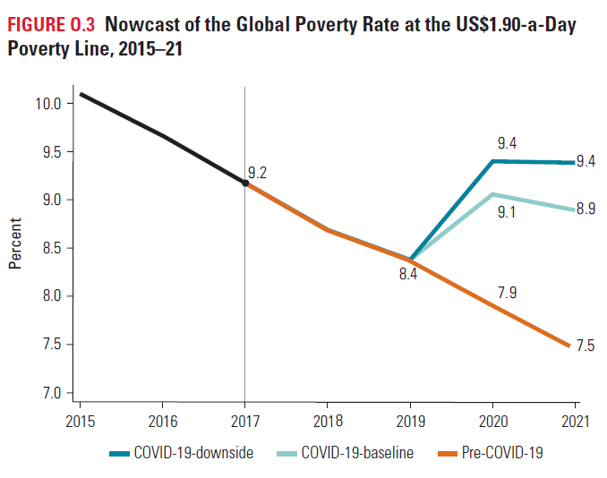
Poverty Outlook
Current number of people in extreme poverty = 689 million
Baseline - 5% contraction
increase of 88 million people by end of 2020
Downside - 8% contraction
increase of 115 million people by end of 2020
Notes:
Source: World Bank, Poverty and Shared Prosperity, 2020

Slide 23
Estimated Projections for Hunger
265 million
83-132 million
WFP – Global Food Crisis Report
Announced in April as “doubling number of hungry”
Crisis-level hunger – IPC/CH Phase 3 or higher
Based on numbers in Phase 2 (stressed)
FAO
Based on three scenarios, using different projections for GDP growth and contraction
Increase in number of undernourished
“people facing hunger”
THIS
COULD BECOME
THIS
Notes:
Source: WFP, announced alongside April 2020 GRFC – no published analysis for this number
Source: FAO, SOFI 2020 – based on 4.9% contraction and 5.4% growth

Slide 24
Messages on COVID - Global
Hunger is estimated to increase by 83-132 million people by the end of 2020
“COVID will push 100 million people into extreme poverty by the end of 2020.”
The most conservative estimates are that global hunger and extreme poverty will both increase by 12%.
There is not a single root cause of hunger that is not worsened by the pandemic and responses to the pandemic.

Slide 25
COVID-19 Impact
Domestic

Slide 26
Domestic Income and Poverty Projections
Notes:
Projections are based on TRIM3 model (Census CPS data)
SOURCE: US Dept of Health and Human Services, Oct 2020

Slide 27
Domestic Income and Earnings *current reporting
Notes:
Source: FRAC, Sept 2020

Slide 28
Messages on COVID -Domestic
Estimates suggest that domestic hunger has already doubled or tripled in 2020 (from 10.5% to as much as 38%).
More than a quarter (27%) of adults in the US are economically insecure.
The social safety net has been working – kind of.
Notes:
SOURCE: FRAC, Sept 2020; U of Arkansas

