Slide 1
What’s At Stake: Medicaid and the Expiring Tax Cuts and Jobs Act (TCJA)
An Overview of LSA & Medicaid and What’s Next
March 6, 2025
Notes:
It is good to be with you all today. As Alesia said – I will be speaking to our work related to Medicaid. There is our advocacy work as well as our broader work related to Medicaid – so I hope you’ll bear with me – as we have essentially divided this into two important and connected parts.
Starting with the more urgent work specific to Medicaid - as President Trump starts his second term and a new Congress gets to work – as you know - there are forces that are putting Medicaid at Risk.
As our advocacy strategy continues to take shape we are working to weave together and leverage our longer-term efforts as we shift to a short-term plan specific to defending Medicaid.
Over the past several weeks, LSA has been working to develop an initial approach to ensure our members are informed and engaged as we work to protect Medicaid.
Today, With the help of Katie Horton at GWU and along with Sarah Dobson and Bill Kallestad on our team – we’re going to share why Medicaid is important to LSA, what we are seeing as the second Trump administration gets started --- and detail the specific threats to Medicaid at the federal and state levels- and discuss our early actions to engage LSA members…
Following that – we are going to move into Part 2 of our Medicaid discussion which centers our work to Strengthen Families. Over the last decade and more (as Medicaid has shifted to Managed Care and Value-Based Payments) – we want to share what we are learning about how LSA and our members are leveraging new flexibilities within Medicaid to improve outcomes for children and families through our fairly new Strengthening Families Initiative. Of course, this builds on our longer-term efforts associated with the Results Innovation Lab.
First, why is Medicaid the top priority for LSA?

Slide 2
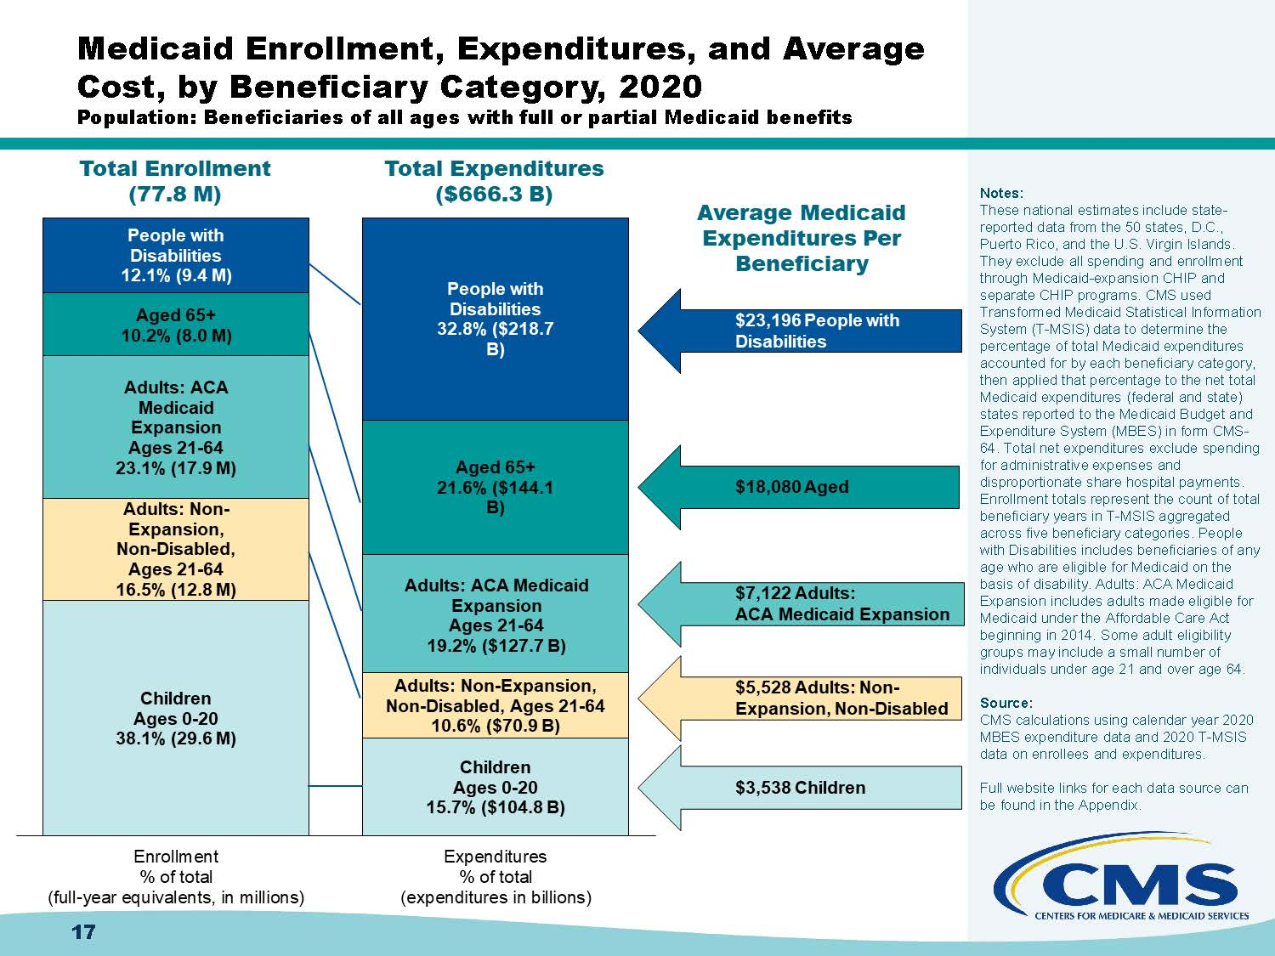
Lutheran Services in America & Medicaid
LSA members work with all Medicaid beneficiaries, including:
Children and Families
People with Disabilities
Older Adults
Notes:
Given the importance of the Medicaid program in ensuring healthcare access and coverage, including behavioral health, to children and families, people with disabilities and older adults, it has been a long-term policy and advocacy priority for LSA. As you’ll see in this chart – individuals covered by Medicaid (the expansion population) has grown in recent years.
(And as you may know - The Affordable Care Act (ACA) allows states to expand coverage to include non-elderly, childless adults with incomes up to 138% FPL; 41 states and the District of Columbia have adopted the ACA expansion)
Medicaid is the largest health insurance program in the U.S., serving ~80 million individuals in 2024
Our aim has been to ensure that the program remains strong and stable given the importance of coverage of essential services that our members provide.
In more recent years, our work has been focused on protecting Medicaid funding to combat attempts to undermine the program.
For example, during the first Trump administration in 2017, we engaged in a robust, targeted advocacy effort to #SaveMedicaid, with the core message of #NoCutsNoCaps when lawmakers and the Administration attempted to change the structure of Medicaid to a block grant program—which would have effectively led to drastic funding cuts to the program.
And we will continue to engage with officials at CMS as they staff up – coming off of last year’s regulatory challenges around SNF staffing minimums – in addition to what Ill describe today.

Slide 3
Policy & Advocacy Priorities
Access to Care
Medicaid
Payment/Reimbursement/Waivers/Demonstrations
Recruitment, Retention, Pipeline and Readiness
Whole-Person Health including Behavioral Health
Health & Housing (connects with Medicaid)
Encompassing quality, safety, affordability, and accessibility.
Workforce
Health and Behavioral Health w Services and Supports to Address Health-Related Social Needs
Notes:
As you may know, as part of our efforts to build out a long-term government relations and advocacy strategy - strengthening our advocacy efforts is a top LSA priority. As we talked about last April - based on key informant interviews with members the following policy priorities really rose to the top –with Medicaid first.
And we know that Medicaid and workforce go hand in hand – since reimbursement through Medicaid dovetails with workforce retention….
And of course–while our long-term aim is to be proactive and amplify our faith-based voice – we will be working to leverage that voice as we shift to ‘defense to protect Medicaid - given the emerging threats– as this will be our main priority in the near term.
So what’s in changing?

Slide 4
What’s Changing?
Trump 2.0– moving from the hammer approach from overall repeal of ACA to using a scalpel if you will –or more surgical cuts.
New Congress with Small Majorities
Major Lever – Expiring Tax Cuts and Jobs Act (TCJA) – Need to Find Pay-Fors….
Medicaid in the Bullseye
Messaging Focus on Efficiency and Effectiveness – so arguments will have to be framed accordingly.
Notes:
Trump 2.0 is different – going from a Hammer to a scalpel approach
Slim Majorities in House and Senate
As you may know, the work of Congressional leaders really started last year – with Republican study committees to prepare for shifts in the governing party and a tax bill in 2025
With the TCJA expiring – this necessitates finding pay-fors as Republicans seek to make estate tax and individual income tax cuts permanent.
Leaving Medicaid in the bullseye
Going forward –as we work to develop fact sheets and messaging – our focus will also be on efficiency and effectiveness – given the focus on DOGE
So, what are the risks to Medicaid?

Slide 5
Risks to Medicaid
From Modern Healthcare – 1/22/25
Murphy emphasized that Congress should still carefully look at ways to save money on Medicaid. That includes enforcing eligibility standards, perhaps changing funding formulas, possibly going to block grants and certainly looking at making the program more efficient, he said. -Rep. Dr. Greg Murphy (R-NC)
What has surfaced in Majority Plans in Congress thus far?
Converting Medicaid from open-ended entitlement financing to "per capita" funding, which would reduce federal support by $900 billion over 10 years.
Eliminating enhanced federal payments to states that expanded Medicaid under the ACA, which would cut the program by $561 billion.
Establishing work requirements for Medicaid, which would reduce spending by $100 billion.
Restricting states from using provider taxes and state-directed payments to coax higher federal Medicaid funding, which would save about $200 billion.
Notes:
Given Medicaid is a federal-state partnership – there are a variety of ways the program can be cut. And we continue to monitor house and senate leadership for statements and what is being raised. Thus far, the House Budget Committee Chairman’s mark – included several cuts to Medicaid, which include:
Imposing Per Capita Caps: A capped allotment per Medicaid enrollee that increases minimally each year, which may not keep pace with rising healthcare costs, unforeseen pandemics, and other public health emergencies
Reducing the enhanced FMAP (currently 90% for ACA expansion states): Eliminating the enhanced FMAP would shift significant costs to states, creating coverage gaps that could lead to the end of Medicaid expansion and cuts to eligibility and enrollment. – 9 states in particular are at risk – which we detailed in yesterday’s CEO Connection.
Imposing Work Requirements: Proposals reinstating work requirements for Medicaid eligibility to cut costs ; CBO has estimated that past work requirement proposals cut $109 billion from federal Medicaid over 10 years
Restricting Provider Taxes at the State Level: Restricting provider taxes at the state level would limit states' ability to fund their share of Medicaid costs, leading to potential cuts in Medicaid services amidst ongoing budget challenges
Moreover per remarks like the one above from Rep. Murphy in NC – we know Block grants also remain in the mix
Block Grants: Block granting Medicaid provides states with a fixed federal funding amount that does not adjust for enrollment growth, rising healthcare costs, new health threats, and widening funding gaps. (A 2017 proposal estimated a 25% funding cut over 10 years and 30% over 20 years (CBO))
And finally we are still watching anticipated administrative action
Repeal of Streamlining Eligibility and Enrollment Rule: CBO estimates a $164 billion cut to Medicaid over 10 years. The rule change will impact people with disabilities by adding administrative burdens to the continuation of coverage
Given this – when do we expect congressional action?

Slide 6
Timing for Congressional Action
Proposed reconciliation timeline from Speaker Johnson:
Week of Feb. 10: House Budget Committee approves a budget resolution, followed by a House floor vote
Week of Feb. 17: Senate vote-a-rama to adopt a budget resolution
A week to negotiate a bicameral resolution that serves as a compromise between the House and Senate plans
Feb 27: Final vote to adopt a concurrent budget resolution backed by Republicans in both chambers
By Easter: Pass a reconciliation package in the House floor
By Memorial Day: Final passage
Early Signal
Notes:
As you’ll see with this proposed timeline from Speaker Johnson – things may move quickly….
To even start the budget reconciliation process (which is where the meat will be) – congress must first come to agreement on a budget resolution – so we’ll get some indications if things are on track by late February.
So, who are the key congressional committees who will inform/guide budget reconciliation on Medicaid….

Slide 7

Budget Committee Cuts - Targets
HOUSE:
Consolidated Approach -
$4.5 Trillion in Cuts being Sought -
$880 Billion specifically targeted at Health – Medicaid
SENATE:
2-Phase Approach
Starting with $1 Billion Target as a Floor

Slide 8
What are the Key Committees to Focus On?
House:
Energy & Commerce – Health Subcommittee
Leaders: Rep. Brett Guthrie (R-KY) & Rep. Diana DeGette (D-CO)
Health Subcommittee: Rep. Buddy Carter (R-GA) & Rep. DeGette (D-CO)
House Ways & Means
Leaders: Rep. Jason Smith (R-MO) and Rep. Richard Neal (D-MA)
House Appropriations
Leaders: Rep. Tom Cole (R-OK) & Rep. Rosa DeLauro (D-CT)
Senate:
Senate Finance
Leaders: Sen. Mike Crapo (R-ID) & Sen. Ron Wyden (D-OR)
Senate Health, Education, Labor, Pensions (HELP)
Leaders: Sen. Bill Cassidy (R-LA) & Sen. Bernie Sanders (I-VT)
Senate Appropriations
Leaders: Sen. Susan Collins (R-ME) & Sen. Patty Murray (D-WA)
Notes:
Given we are planning for a budget reconciliation process – as only a simple majority is needed to pass legislation – our focus will be on several key committees with jurisdiction including the tax writing committees (given the tax bill), Senate HELP and House E&C/Health Subcommittee who deal with health issues more broadly –and appropriations given that is where the money will be managed…
So, what are we doing to mobilize LSA members?

Slide 9
Now What?
Contact your member of the House of Representatives and your two Senators
They need to understand the implications of cuts to Medicaid.
Capital Conversations – On-Going…
JOIN US - March 20
Meeting Registration – Zoom
Take Action: https://lutheranservices.org/take-action/#/

Slide 10
Questions?
Sue Polis: Spolis@lutheranservices.org
Sarah Dobson: Sdobson@lutheranservices.org
Bill Kallestad: BKalledstad@lutheranservices.org

